Slide 1

State of Montana
Statewide 9-1-1 Plan Project
Town Hall Meeting
December 3rd, 2018

Slide 2

Introductions
Federal Engineering
  Eric Parry, Program Manager
  Kraig Kaizumi, Senior Consultant

Slide 3
Topics
Introductions
Our Firm
Project Overview
Introduction to Next Generation 9-1-1
PSAP Survey Tool
Question & Answer Session (Optional)

Slide 4
Our Firm
Leading public safety consultant
  Over 34 years of successful programs
  A unique suite of technical and operational services
Projects across the U.S.
  Clients benefit from our experience and gained insight
  Varying public safety deployments, emergency response operations
  Our understanding of your unique circumstances
FE’s proven capabilities
  Deep bench of experienced consultants and strategic partners
  E-911/NG9-1-1, CAD/RMS, PSAP, LMR expertise

Slide 5
Project Communication
Points of Contact (POC)
  Federal Engineering - Scott Strom, Project Manager
  Montana – Quinn Ness, Bureau Chief
  Montana – Rhonda Sullivan, 9-1-1 Program Manager
Status/Progress Reporting
  Reporting of project progress and status

Slide 6
Project Scope
Stakeholder Engagement
  Prepare and review Stakeholder Communications Plan
  Develop and distribute Collection Tool
  Coordinate logistics for seven Regional Town Hall Meetings and subsequent PSAP visits and interviews
  Develop Regional Town Hall Meetings Summary Report

Slide 7
Project Scope
PSAP Inventories
  Accurately capture and document existing inventory and readiness of PSAPs for evolution to NG9-1-1
  Develop summary of survey data and interview results from each PSAP
  Capture collected PSAP 9-1-1 inventory into database for ongoing validation and resource in developing PSAP Needs Assessment Reports

Slide 8
Project Scope
ESInet Inventory
  Accurately capture and document status of the existing statewide 9-1-1 network and its stage of advancement to a full NG9-1-1 ESInet
  Work with CenturyLink to obtain current network diagrams, maps and current bandwidth availability and utilization
  Capture collected ESInet inventory into database for ongoing validation and reference

Slide 9
Project Scope
NG9-1-1 Technology Standards and Requirements
  Recommend standards to the State for ESInet, network security, GIS data, call delivery, and call processing based on NG9-1-1 national standards
  Develop a preliminary set of NG9-1-1 technology requirements

Slide 10
Project Scope
PSAP Needs Assessment
  Identify required technology, hardware, and software upgrades necessary for PSAP to become NG9-1-1 capable and develop transition strategies and recommendations for each PSAP

Slide 11
Project Scope
NG9-1-1/ESInet Design and Implementation Plan
  Develop and validate ESInet requirements
  Develop and present recommended requirements, designs and implementation plans for a statewide ESInet

Slide 12
Project Milestones
Milestone |  | Timeline
Milestone 1: Completion of Project Plan and Communications Plan |  | November 27, 2018
Milestone 2A: Completion of First Half of Stakeholder Engagement (PSAP surveys, town hall meetings & PSAP visits/interviews) |  | January 8, 2019
Milestone 2B: Completion of Second Half of Stakeholder Engagement (PSAP surveys, town hall meetings & PSAP visits/interviews) |  | February 18, 2019
Milestone 3: PSAP Inventories |  | February 1, 2019
Milestone 4: ESInet Inventory |  | January 15, 2019
Milestone 5: NG9-1-1 Technology Standards and Requirements |  | April 9, 2019
Milestone 6: PSAP Needs Assessments |  | May 14, 2019
Milestone 7: ESInet Design and Implementation Plan |  | June 11, 2019

Slide 13

Introduction to Next Generation 9-1-1

Slide 14
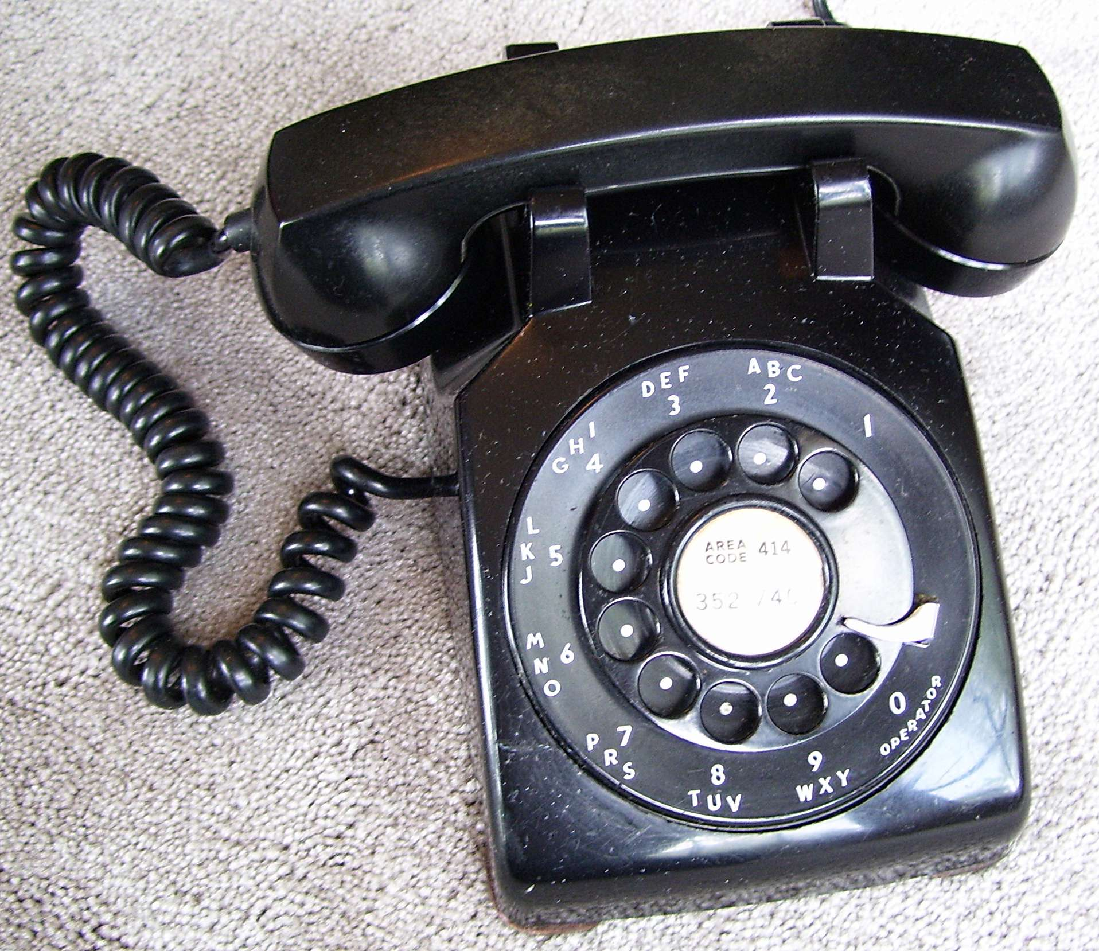
Do You Have the Same Telephone You Had in 1968?
Notes:
The same phone you had 10 years ago? 2 years ago? Not much longer with that for most of us and our upgrade schedule with the wireless carriers
How about

Slide 15

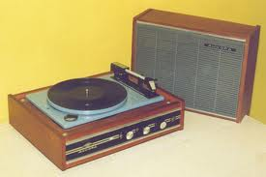
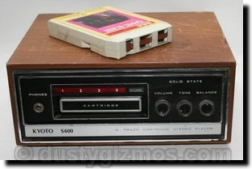
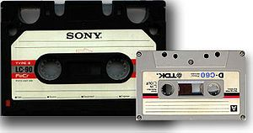
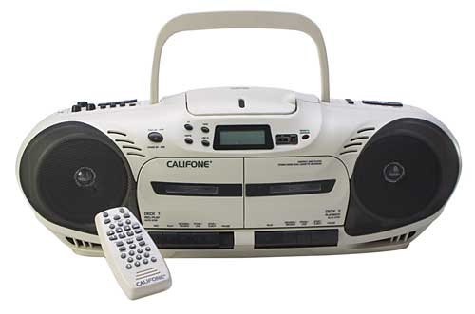

Do You Play Music the Same Way You Did in 1968?
Notes:
The same phone you had 10 years ago? 2 years ago? Not much longer with that for most of us and our upgrade schedule with the wireless carriers
How about

Slide 16
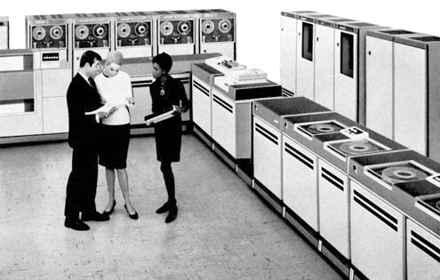





Do You Have ANY of the Same Technology You Had in 1968?
Notes:
The same phone you had 10 years ago? 2 years ago? Not much longer with that for most of us and our upgrade schedule with the wireless carriers
How about

Slide 17


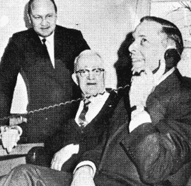
Do You Know that You Have the Same 9-1-1 System As 1968?
Not Completely . . .

Slide 18

Do You Think it is Time for Next Generation 9-1-1?
Why or Why not?
DOES THE GENERAL PUBLIC?
Notes:
Resolving Infrastructure Limitations
Equal Access for Hearing Impaired
More Functionality
Increased Data Sharing with PSAPs, and other emergency service providers & responders
Need for National and International Interoperability
Increased disaster response options
Prepare for Unpredictable Future Services
ANY DEVICE, ANY TIME, ANYWHERE. . .

Slide 19


What is NG9-1-1?
A simple, open architecture that uses a secured, managed IP network and gateways, to manage information sets supporting:
        Voice & Text Messaging
        Data
        Video, and
        Whatever the Future Holds!

Slide 20










Next Generation 9-1-1
ANY DEVICE, ANY TIME, ANYWHERE!

Slide 21
WHY IT IS TIME FOR NG9-1-1
Resolving infrastructure limitations
Easing regionalization logistics
Reducing long term costs – Virtual (hosting) of services
More functionality and optional features
Faster info exchange with other PSAPs
Improved caller location = faster call taking and dispatch
Ability to manage spikes in call volume
Notes:
Support a wider range of devices coming on the market
Improve the ability of the network to survive and provide service in disasters
Lower costs – shared services & partnerships
Legacy systems have to gateway to the ESInet, and there is a cost to that
However, no specialized service providers (MPC/VPC/SSP) are needed, so operations expense could be lower
Improve the quantity and quality of data available to 9-1-1 and responders
IP/Standards Platform allows for:
Easier integration of disparate systems
NCIC, LETS, CAD, Radio, Video, Phone, and ??? all on one IP platform
Improved Data connections:
Potentially anywhere there is a network connection
Faster call set up times (Mbps versus Kbps) and faster call completion due to higher bandwidth and modern signaling protocols (NG9-1-1 goal is 2 seconds from last keypress to ring at PSAP)
Lose the delay created by CAMA trunk call set up
Less expensive connections from the carriers
NG9-1-1 will support direct connections by enterprise to the ESInet from the initial deployment. “Secured” connections are possible, but calls can arrive from the Internet. We need to tell people that, but also say that there are firewalls and other border control functions to mitigate attack, and ultimately, it can be turned off if we need to do that.
Improved redundancy everywhere if implemented correctly
Border Gateway Protocol peering with multiple carriers
Improved reliability through inherent capability of IP networks to automatically reroute around failures. Experience shows that well engineered IP networks allow communications when other kinds of networks fail, and the reliability is achieved at modest cost and complexity
Employees can answer calls anywhere there’s a network
Call takers that can’t get in during snowstorms
Call centers can be moved quickly to another location with network connectivity.
Don’t need carrier circuits to redirect.

Slide 22
WIIFM? Benefits of NG
We can provide better service
Supports a much wider range of devices and services
Improved coping in disaster situations
Telco competition – non-proprietary solutions that are available “off-the-shelf”
We have a bigger say in our own destiny

Slide 23
Primary Components of Next Gen 9-1-1
CPE (9-1-1 Call Taking Equipment)
Network (IP)
Database
GIS (Graphic MSAG & Auto Location)
IT (Security, Upgrades & Maintenance)

Slide 24
Secondary Components of Next Gen 9-1-1
Funding
Politics
Personnel Issues
Public Education
PSAP Training
Liability
Legislation
Partnering & Sharing Data

Slide 25
Transition to NG9-1-1
Not going to happen overnight!
We are developing a plan
This is a statewide system – not a State system
NENA and US DOT developed transition plans
Every PSAP has a say

Slide 26
Regional & State ESInets – Network of Networks
Interconnects PSAPs & facilitates interoperability
Access
Transfers
Enhanced alternate & contingency routing
Remote PSAP capability
Emergency Notification Systems

Slide 27
State ESInets – Network of Networks
Notes:
Possible scenarios for the NG9-1-1 architecture diagram discussion:
1. Devices connected through the Internet - As it does IP registration, each device discovers its location either internally (GPS or other methods, or from a Location Information Server (LIS)). Location has been validated at device IP registration, prior to and in preparation for actual 9-1-1 call. Calls with location flow from the originator through the Internet, using the routing function to determine destination PSAP. Call enters the Emergency Services IP Network through robust firewall and security processes, and is delivered to the PSAP IP address with location and callback info. Other data is accessed by query or automatically based on PSAP defined parameters in a rights management system.
2. Legacy wireline and wireless service prior to direct IP connectivity: These providers enter the Emergency Services IP Network in their local area directly (no Internet link) through an SR gateway from the respective Selective Router, using the PSAP IP address if the PSAP is IP capable, or an IP address to the appropriate PSAP gateway connecting to the legacy PSAP. ALI is accessed in the current way (direct data links) and other data is accessible via the PSAP gateway via the Emergency Services IP Network.
3. Legacy wireline and wireless interface via IP: Legacy switches will likely never have a direct IP interface for 9-1-1, as they are not being updated due to the move toward an IP based network. However, IP connectivity for general networking (including 9-1-1) will likely be provided through more central `tandem' switches, allowing connectivity to the Emergency Services IP Network for NG9-1-1 and the beginning of transition away from physical Selective Routers.
4. Telematics calls and data access: Initially, until Emergency Services IP Networks are available nationally for public safety applications, calls from telematics call centers would have to enter the Emergency Services IP Network via the Internet. Once the call is delivered to the PSAP, data access would have to be via the reverse path back to the telematics servers. When a telematics provider is able to access the Emergency Services IP Network in their location directly (not via the Internet), and be capable of utilizing the national Emergency Services IP Network (network of networks concept), direct interaction for calls and data becomes the norm.
5. Text only devices (IM, 2 way pagers, PDAs, specialized use devices, etc):and video-oriented services: Whether communication is via an Internet based services or via wireline or wireless connectivity, NG9-1-1 supports text only message routing and delivery to IP capable PSAPs via Emergency Services IP Networks. This is also true for Video Relay Services for the hearing impaired, and for transmissions involving still and motion video information, assuming the necessary bandwidth is available.

Slide 28
How Regional ESInet Will Work With NG9-1-1
Routing determined based on location at time of call setup
  Emergency Call Routing Function (ECRF)
  Either civic or geo location
Routing can be changed when needed
  Policy Routing Function (PRF)
  Routine or contingency
  Border Control Function (BCF)
Location information arrives with call
Additional data available to be forwarded
Notes:
Contract for a statewide Emergency Services IP network (ESInet) through DIR
Lead database development efforts
Support core services e.g. rights management
Allocate costs to state program and Districts

Slide 29
PSAP Data Collection Survey Tool

Slide 30
Data Collection Survey Workbook
Overview
  Needed from each PSAP to gather necessary and vital information for guiding the 9-1-1 Advisory Council’s award of state 9-1-1 grants
  Workbook is comprised of four (4) tabs
    Directions
    Contact Info
    Technology
    Facilities

Slide 31
Data Collection Survey Tabs
Directions Tab
  Begin with the tab labeled "Contact Info" work your way through each tab of the workbook.
  Fill out the forms the best of your ability. Not all information may apply to all PSAPs. If you are not sure how to answer or fill out a question, leave it blank. We’ll review the forms with you during our onsite interviews.
  Your input is important to this process. Should you need more space to properly address a question,. Alter the form to for any additional space needs.
  Yellow color boxes are drop down menus to select the correct answer. You can override if needed to add your answer.
  Complete the survey as soon as you can and email it to Kraig Kaizumi at kkaizumi@fedeng.com
  Once the submitted survey is returned we will schedule a call to review the response.

Slide 32
Data Collection Survey Tabs
Contact Info
  Primary Contact (Name, Telephone, Cell Phone, Email, Fax & Address)
  Alternate Contact (Name, Telephone, Cell Phone, Email, Fax & Address)
  Technical Contact - If different from Primary contact)
  Operations Contact - If different from Primary contact
  Develop Regional Town Hall Meetings Summary Report

Slide 33
Data Collection Survey Tabs
Technology
  Computer Aided Dispatch
    Basic System Information
    Functionality
    Interfaces
  Mapping/GIS
  Mobile Data Computers (MDC)
  Customer Premise Equipment (CPE) - 9-1-1 Telephony
  Master Street Address Guide (MSAG)
  ALI Database

Slide 34
Data Collection Survey Tabs
Technology (Cont.)
  Logging Recorder
  Instant Recall Recorders - 9-1-1 Answering Positions
  Instant Recall Recorders - Radio Consoles
  Instant Recall Recorders - Admin Phones
  Administrative Phone System
  Alarm Monitoring
  Master Clock
  Emergency Dispatch Protocols / Software
Facility
  Building and Site information

Slide 35

Questions and Answers

Slide 36
State of Montana
Statewide 9-1-1 Plan Project
Federal Engineering
Thanks You for this Opportunity!

