Slide 1
Perceptive Content
The State of Montana Enterprise Content Management (ECM) System a Hyland Product
Presented By:
Elle Arredondo (DLI), ECM Workgroup Chair
Boah Kang (DOJ)
Chris Bernet (DLI)
Patrick Miller (DOR)
Teri Juneau (DOC)

Slide 2
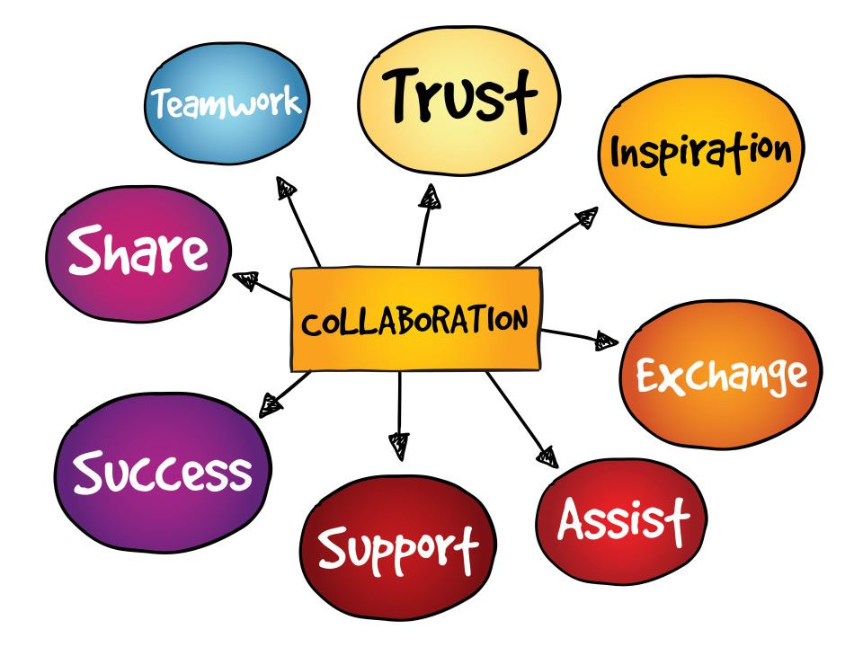
Introduction
“Digital transformation isn’t a destination. It’s a journey.”
- Ed McQuiston, Executive Vice President
Hyland Software
Notes:
Unique use cases – leveraged tool and usability
Collaboration – shared information, best practices

Slide 3

DOJ Barcode Process
MVD Vehicle Service Bureau
Boah kang, doj IT

Slide 4
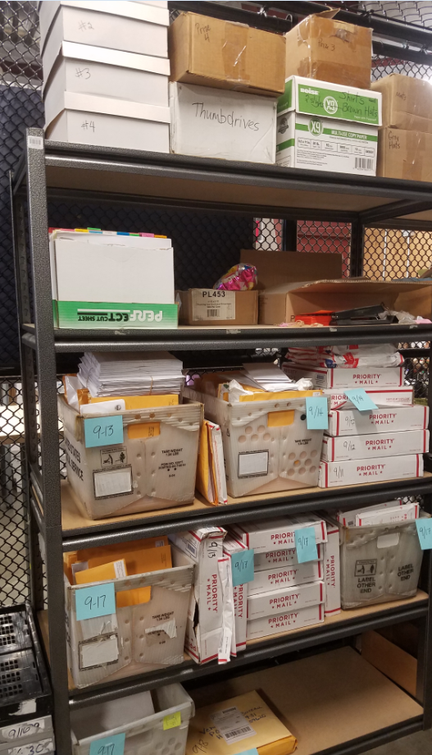
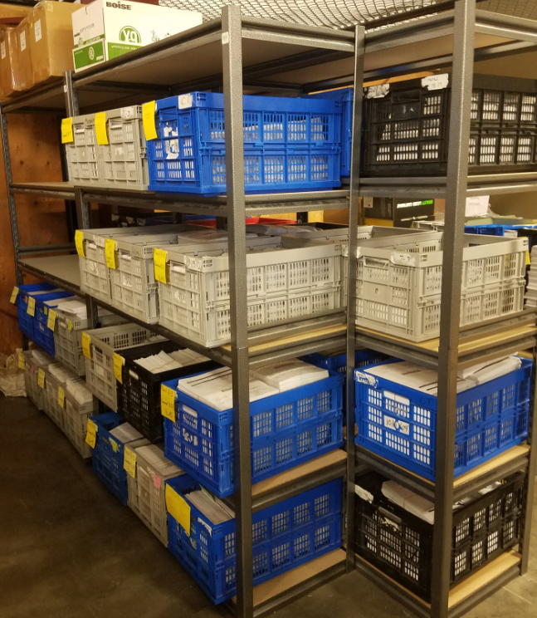
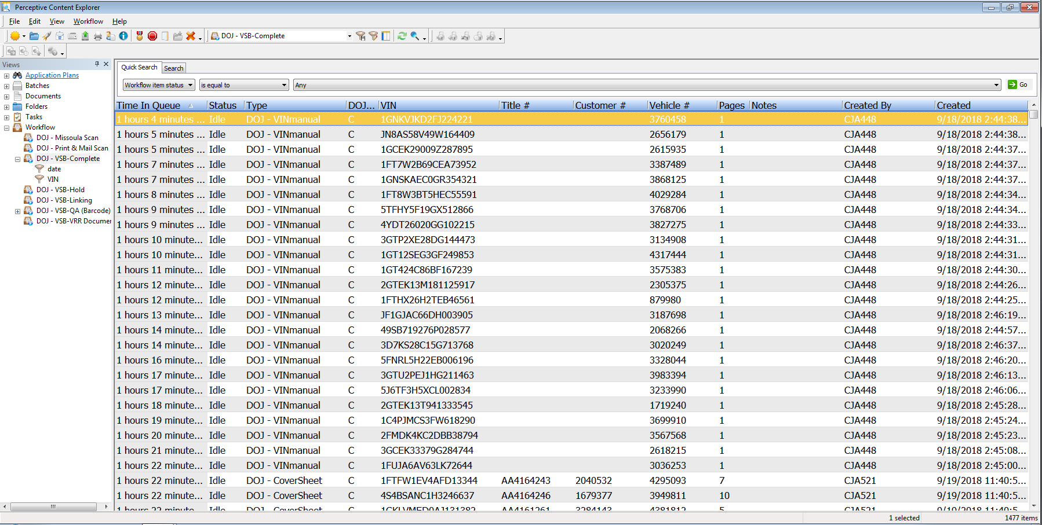
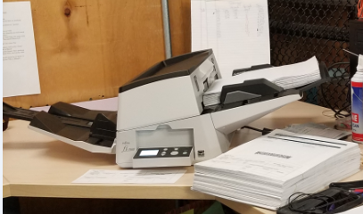
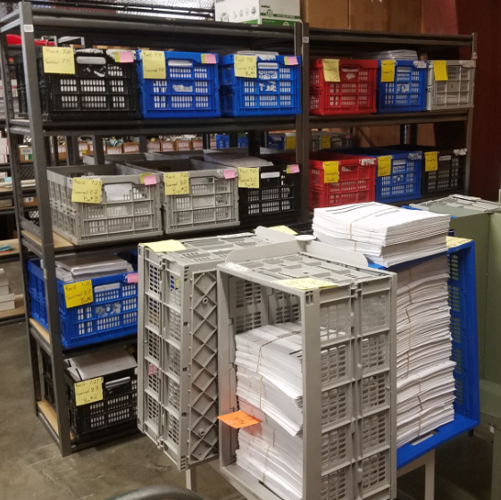
SCAN THEM AWAY~
Papers to Paperless

Slide 5
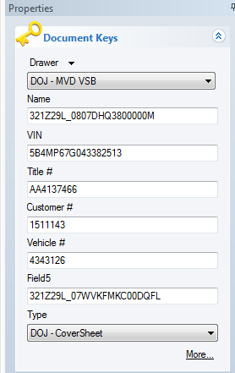
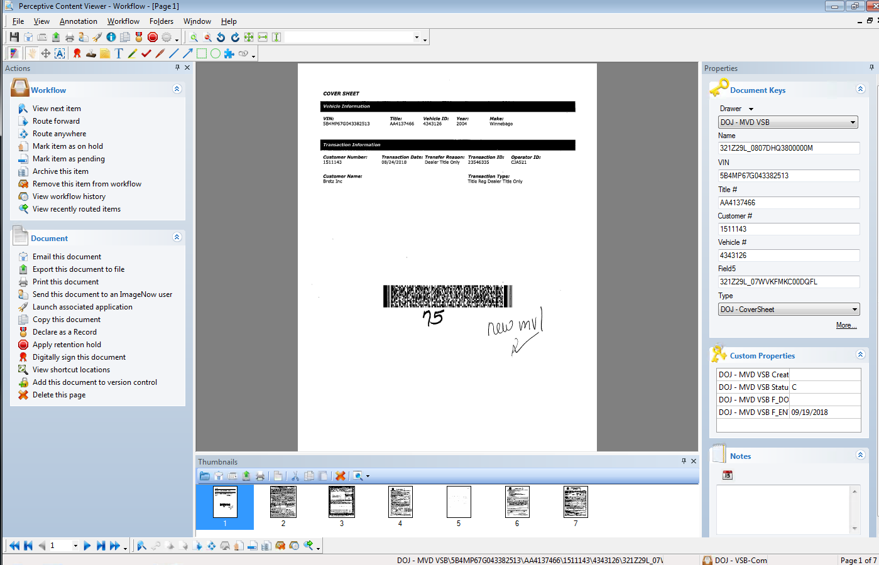
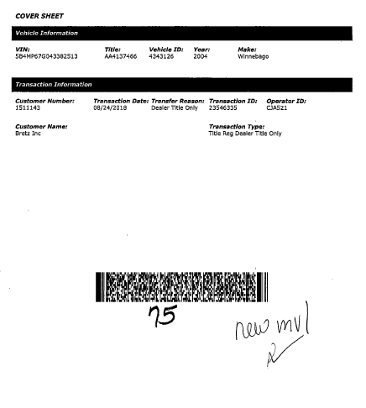
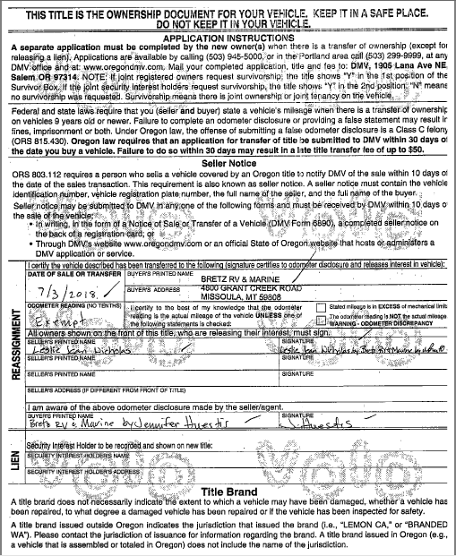
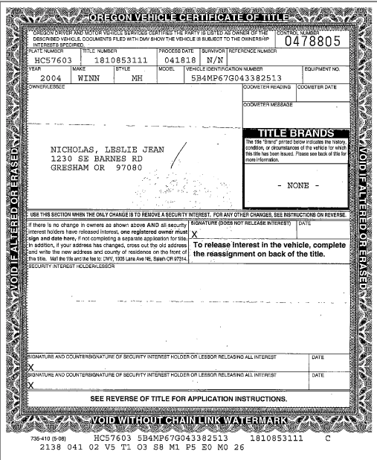
BARCODE CONFIGURATION
Bulk upload
Auto indexing
Auto separating documents
Auto Indexing

Slide 6
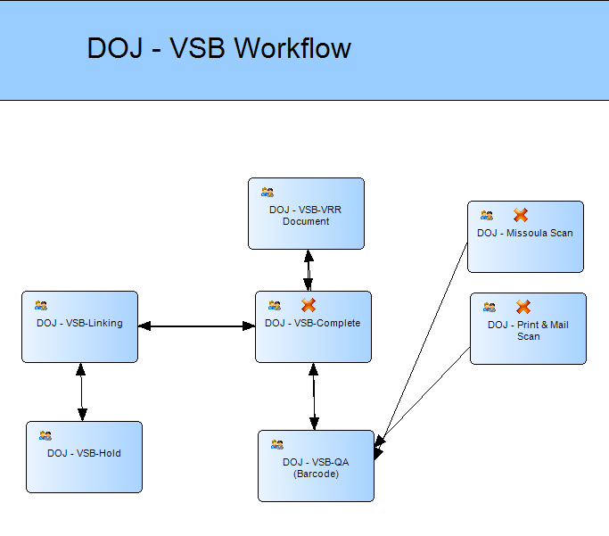
MVD VEHICLE SERVICE BUREAU WORKFLOW

Slide 7
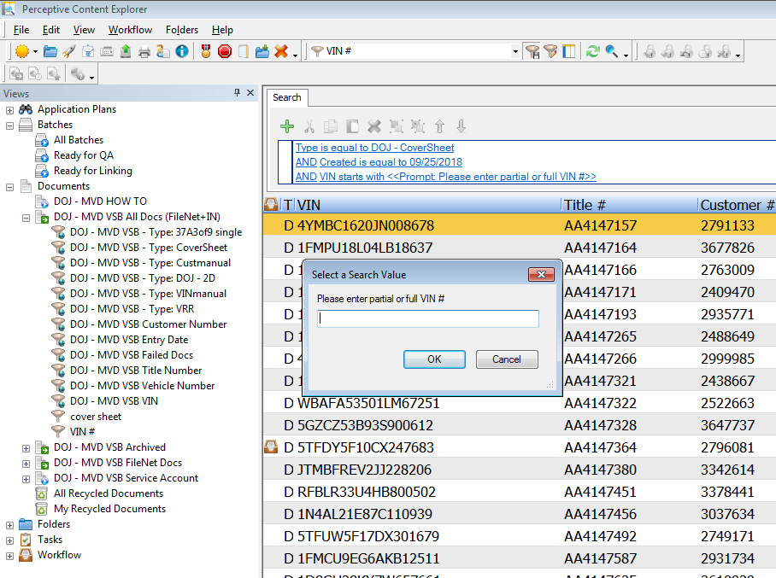
EASY & DYNAMIC DOC SEARCH
Search by any key indexing field, custom property field, user, date and other criteria

Slide 8
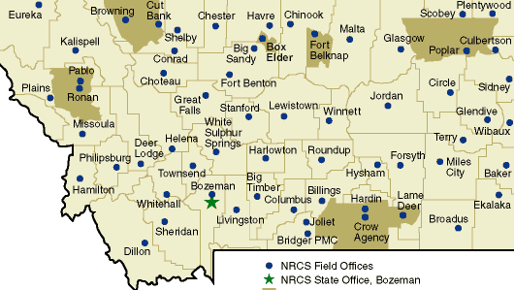


PARTNERSHIP WITH PRINT & MAIL
MVD WINs
P&M WINs
Reallocate 3-5 FTE
Decrease customer phone wait time
Increase work productivity
Less maintenance Cost
Increase revenue
New line of business
Hire additional staff
DOJ other processes and other agencies on board

Slide 9
EFFICIENCY IMPROVEMENT
No manual data entry
  No human error
  Save time and cost
Increase customer satisfaction
Easy to search documents
Change the storage room to the office for staff
Increase productivity
Successful augmentation project of agencies

Slide 10

DLI Fiscal Solution
Goodbye Paper Process!

Slide 11

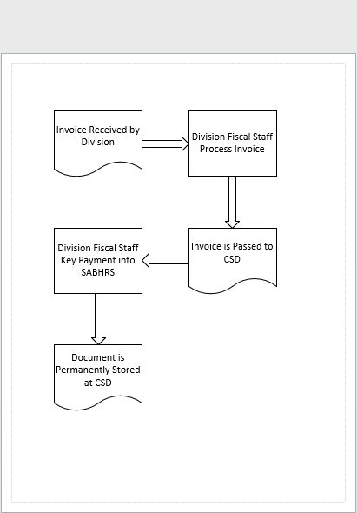
The Lifecycle of an Invoice Document
Divisions receive an invoice
Invoice is processed by division fiscal
Invoice is passed to Centralized Services Division (CSD)
CSD keys payment into SABHRS
CSD permanently stores invoice

Slide 12
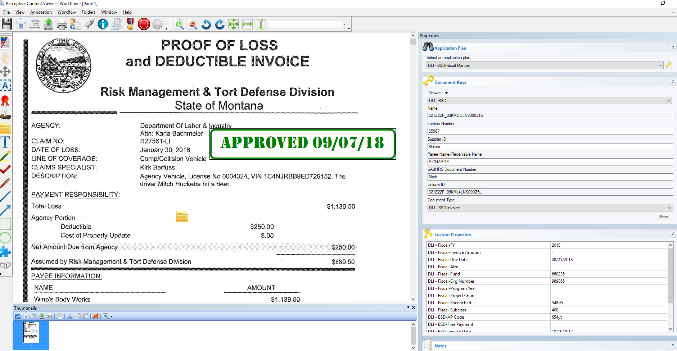
Division Processes Invoice in Perceptive
Ingesting Documents
Email
Network Folder
Coding & Approvals
Approval Stamps
Fiscal Year, Due Date, etc.

Slide 13
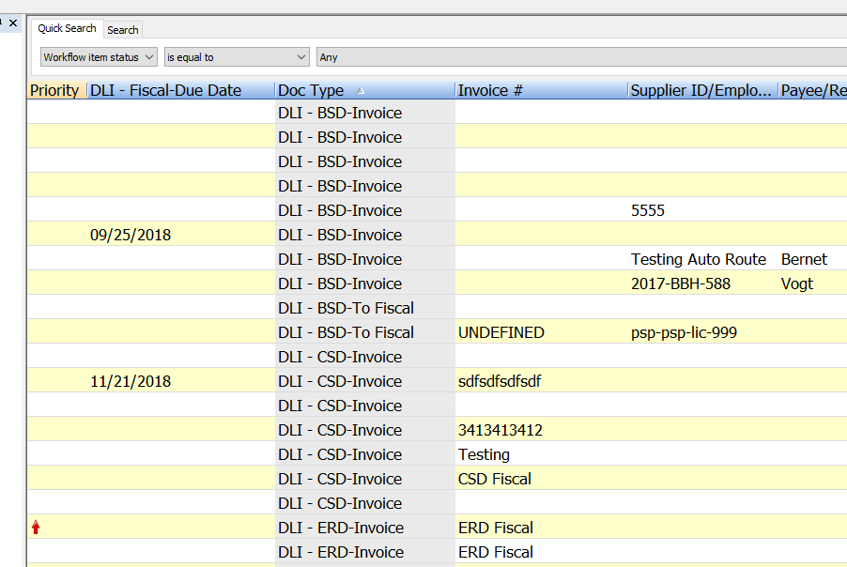
Workflow Used to Route Invoice to CSD
Documents routed to CSD via Perceptive workflow.
System recognizes the document type of invoice
CSD receives the invoice document in a workflow sub-queue

Slide 14
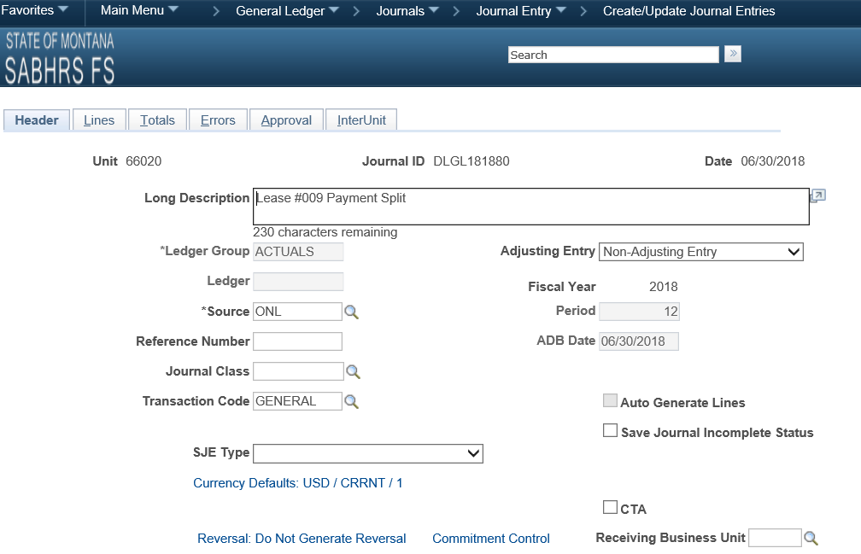
CSD Links Invoice Against SABHRS – and Done!
CSD keys the payment into SABHRS
CSD then “links” the document
CSD completes the process and stores the document permanently in Perceptive.

Slide 15
Final Thoughts
APPROVAL INTEGRITY – only authorized staff can use approval stamps
TRANSPORTATION SAVINGS – no more driving paper across town
EASY TO BUILD – mostly built in house without developers
TRANSPARANCY – division staff can view document through entire lifecycle
AUDITS – easy to produce documents for audit
LATTE STATION – this goes where the filing cabinets used to be!

Slide 16

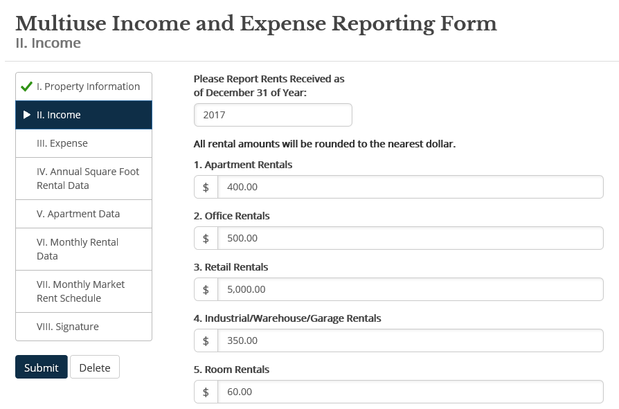

Montana Dept. of Revenue
Managing Web Form Submissions:
Notes:
Summarize how content is captured thorough MyRevenue

Slide 17
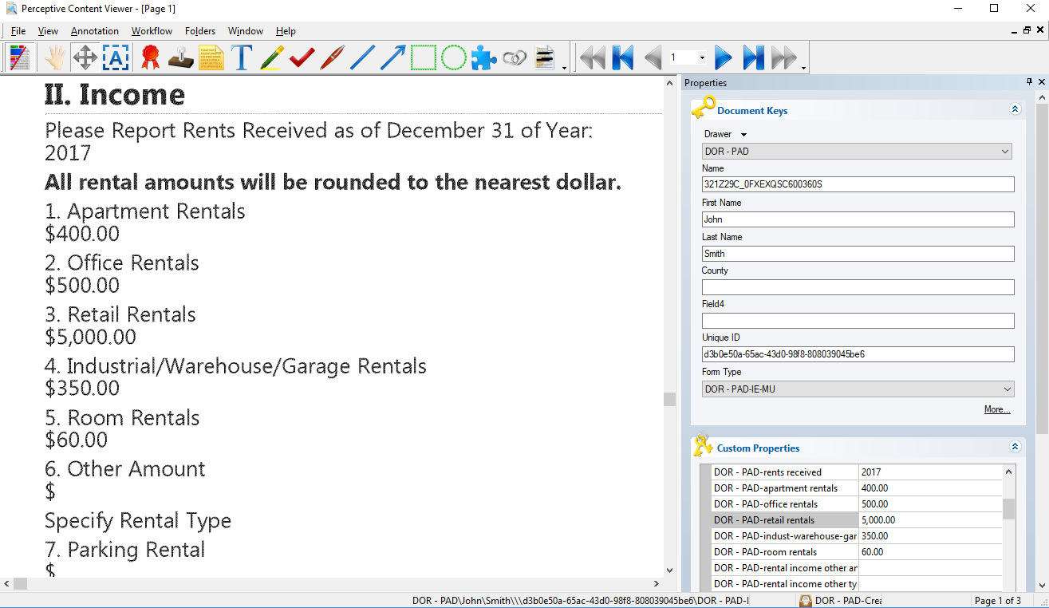
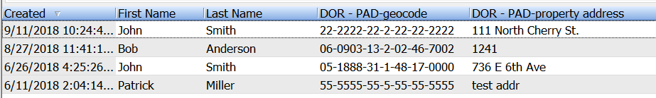
View and report on submissions
Notes:
Content can then be viewed and edited and then reported on.

Slide 18
Web form submission life cycle
Perceptive Manages content for:
Property Assessment Division
Office of Dispute and Resolution
Alcoholic Beverage Control Division
Directors Office
Notes:
Perceptive has a significant role in managing content throughout the Department. It is an ideal tool to help store and collect content that needs to be diverted to another solution.

Slide 19

Commerce
Background
Resources
Benefits
Process
FileNet to ECM Conversion
Demo
2 Staff (Accounting & IT)
ITSD & Perceptive Costs
Improve Efficiencies
Leveraged Agencies Help
3 Months
Cross Reference Documents
Uninterrupted Business
Built Application Plan
Created Workflow
Created Relationships
Kyocera Scanner/Copiers
Staff Time, Filing, Self Service
Notes:
Overview
Converted systems from File Net to Perceptive
Prior to Perceptive, we stored our contracts in Filenet
Invited to demo that Justice provided on using Perceptive for their accounting workflow making it a paperless process
After joining ECM determined that DOC could improve efficiencies in accounting by converting to digital system and chose ECM because contracts were already in the system.
Resources
We started this project with no budget
Sent one accounting and IT employee to training ($6,000). A division paid for an IT person and the Accounting Manager to attend class
Had Licenses already from conversion, Drawer cost, In training Hyland told us the licenses were concurrent so we thought we could us the workflow starting with the division staff and route it all the way through the approval process in SABHRS- however we found out that SITSD does provide agencies with concurrent licenses so we had to modify our processes
We started with the accounts payable workflow. Justice shared their workflow with us and macros and we decided to simplify them and create a simple workflow for each accounting process
Used macros and scripts from DOJ and DLI and leaned into ECM workgroup for support as needed.
Leveraged current Kyocera copiers so employees can scan in financial documents and then they are imported directly into perceptive.
Our challenge was getting the documents scanned from the divisions in the proper formatting
Scan to Kyocera Copiers. We found out DLI had a FCC script to complete this. They exported it and sent it to us. We modified the script and SITSD helped us get it working.
Captured into Perceptive and converted from PDF to TIF
Routed for signatures and approvals in accounting section using annotations. Justice provided advice on routing, shortcuts and ideas for these processes. We also were able to get scripts from DLI, Justice, OPI, and Hyland to compare and get one working for us
Took 3 months to convert 5 processes
Benefits
Cost Savings-filing, paper, staff time retrieving documents, routing documents
Related documents such as pro card statements to invoices or vouchers to contracts
When employees are out others can jump in and pick up where they left off and continue processing without having to track down paper documents
Process

Slide 20
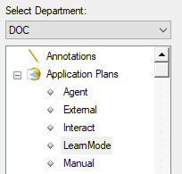
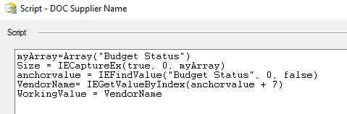
Commerce
Set up Application Plan
Used Learn Mode to capture information from SABHRS
Started with Scripts from DOJ and altered for DOC
Notes:
Set up Application Plan
Built the application plan in Learn Mode to map components to capture from either SABHRS screens or from scanned documents) or use Manual to enter data. Right now it is tough to capture SABHRS screens because the data constantly moves on the screen so it will work for 2 or 3 documents and then may break. Updates to web browser or SAHBRS can also break this so we are hoping to find a way to have a static screen for this SAHBRS info.
This is where the scripts are needed. We copied ours from DOJ and then worked with Hyland to tweak it a bit to work for our documents.
Identify fields to capture and which ones will be indexed/required. These become searchable fields. They can also be used to set routing rules later in workflow.

Slide 21
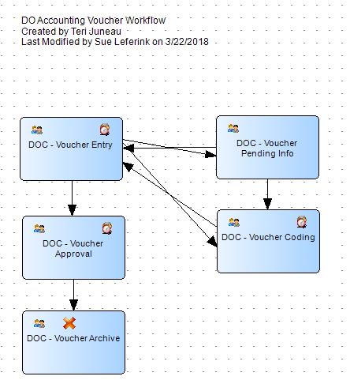

Commerce
Create Workflow
Set up Alarms to send emails when documents are in the queue
Workflow was created by the Accounting Manager using the Internal Control Plan
Notes:
Create Workflow
Map out Business Process and created workflow
Set up routes, alerts and set security

Slide 22
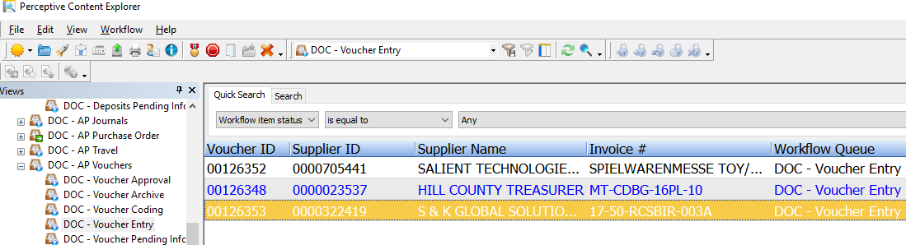
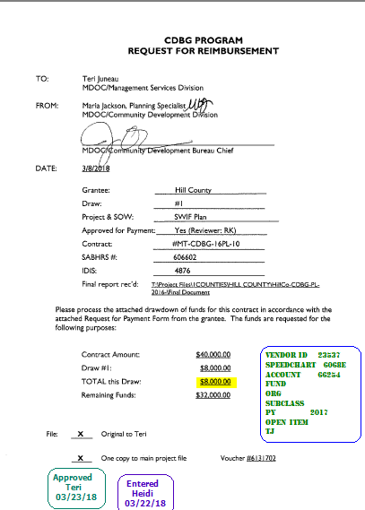
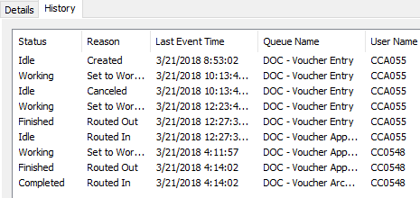
Commerce
Process Documents
Workflow Queue
Processed Document
Audit History
Notes:
Process Documents
Document is scanned into Kyocera Copiers or captured via print driver into Perceptive
Goes through workflow to convert from pdf to tif so that we can use Annotations/Stamps to process/approve and code documents. We were able to reuse this process created by DLI for our drawer after some testing and tweaking.
Goes into the proper workflow and the queue shows where documents are in the process. If blue that means the document has been in this queue previously.
We can see the history of the document throughout the process and who did what with it.
The document contains all the coding and approvals and can be exported with these annotations.

Slide 23
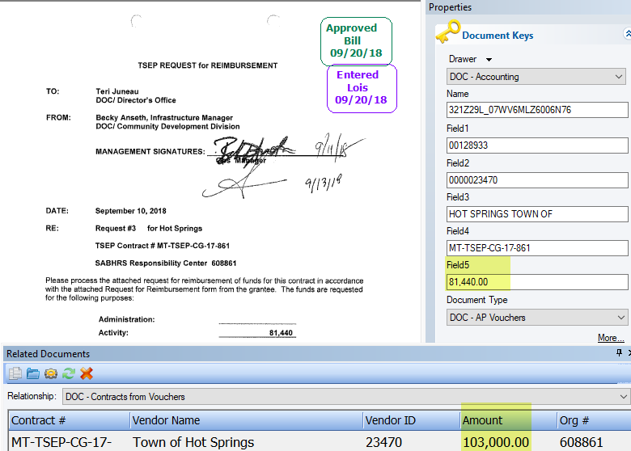
Commerce
View Related Documents
Verify there is a valid contract before processing the voucher

Slide 24
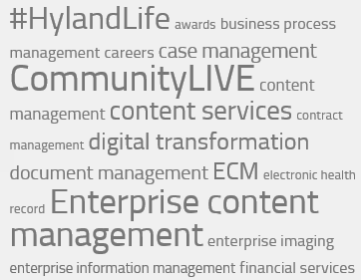
Conclusion
Next ECM Workgroup Meeting: November 28, 1:30 – 3:30 PM
ECM Workgroup SharePoint site:
https://ent-sp1.mt.gov/sites/ecm/_layouts/15/start.aspx#/SitePages/Home.aspx
For more information, send an email to:
Elle Arredondo, elle.arredondo@mt.gov
Or
Judy Kelly, jkelly@mt.gov

