Slide 1
Microsoft Training Vouchers
Donald Scott
Microsoft Technical Account manager

Slide 2
Software Assurance
Software Assurance benefits help you take full advantage of your investments in IT.
Reduce software and services costs with rights to new software releases and cost-efficient upgrades.
Use consulting services to plan new, on-premises and cloud-based deployments.
Improve operational efficiency through access to unique technologies and licensing rights.
Increase overall user productivity with instructor-led technical training and online end-user training.
Maintain an available and responsive IT infrastructure with around-the-clock support

Slide 3
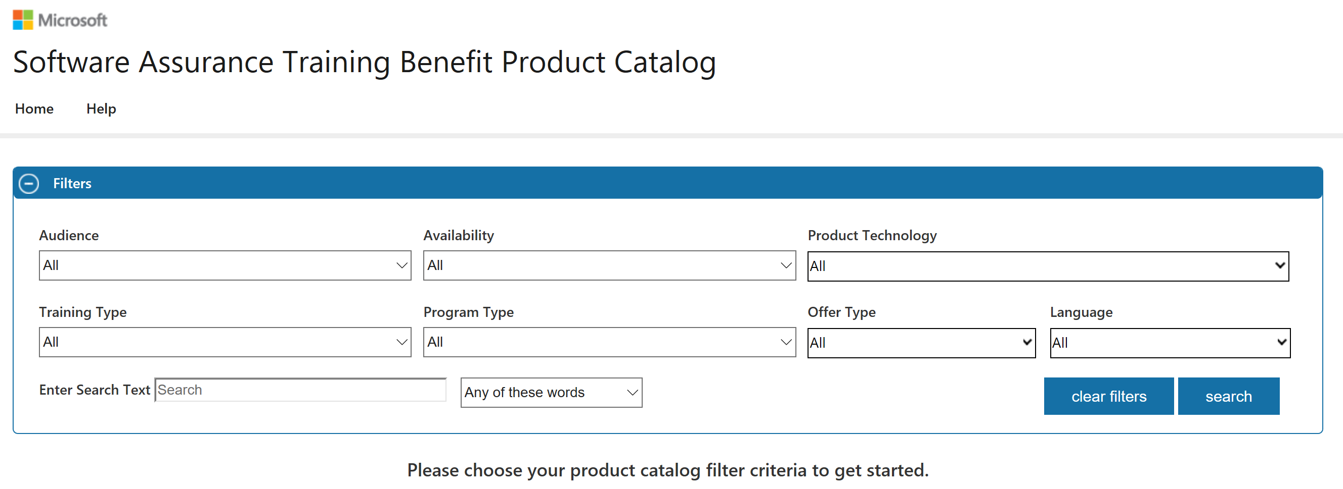
What are Microsoft Training Vouchers
Training Vouchers are apart of Software Assurance Benefits
Credits on EA that can be used for training
Measured in Days
Work with training provider to determine required number of days.
Over 1000 providers
https://www.microsoft.com/en-us/learning/partners.aspx

Slide 4
Benefits determination
Software Assurance Membership (“SAM”)
Based on spend for SA in Application and System pools
Entitlements are calculated on a points-based system
Details located in your licensing terms.
https://www.microsoft.com/en-us/Licensing/product-licensing/products.aspx
Program | Office System Application Pool products | Systems Pool
Open Value | 2 days per 50 licenses (maximum 20 days) | 1 day per 50 licenses (maximum 10 days)
SAM 1-249 | 2 days per 50 licenses or points | 1 day per 50 licenses or points
SAM 250-2,399 | 20 days per eligible enrollment or Purchasing Account | 10 days per eligible enrollment or Purchasing Account
SAM 2,400-5,999 | 30 days* | 15 days*
SAM 6,000-14,999 | 50 days* | 25 days*
SAM 15,000 – 29,999 | 110 days* | 55 days*
SAM 30,000 – 49,999 | 160 days* | 80 days*
SAM 50,000 – 99,999 | 250 days* | 125 days*
SAM 100,000 – 199,999 | 400 days* | 200 days*
SAM 200,000 – 399,999 | 600 days* | 300 days*
SAM 400,000 – 599,999 | 800 days* | 400 days*
SAM 600,000 + | 1400 days* | 700 days*

Slide 5
How to Use
Listed on Volume Licensing site under active EA
https://www.microsoft.com/licensing/servicecenter/default.aspx
Access is granted per organizations Software Assurance Manager
Before expiration of EA. Use within 180 days of allocation
Can be converted to planning services days at a 3 -1 ratio

Slide 6
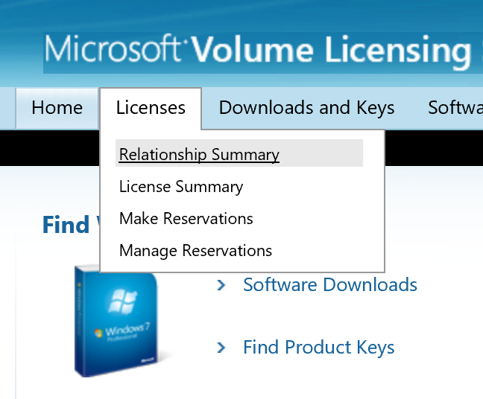

Slide 7
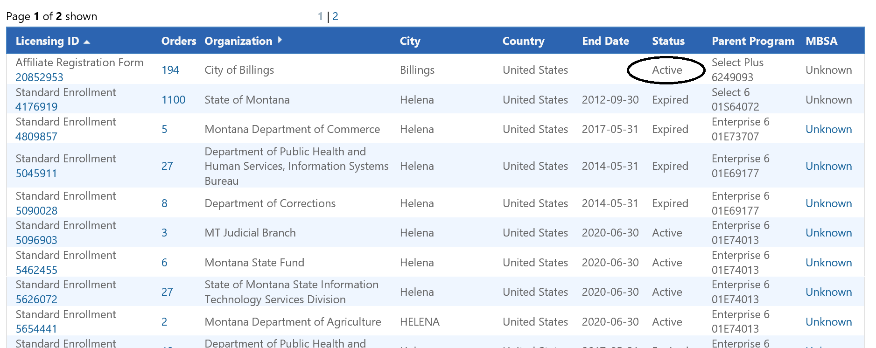
Identify your Active contract
Expired contracts you have permissions to will be visible
If you don’t see a contract it is because you do not have rights

Slide 8
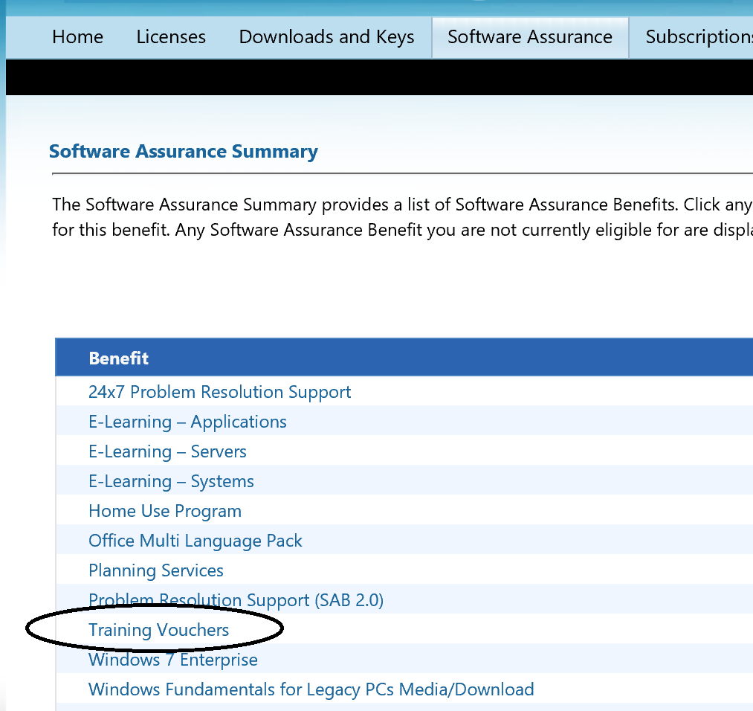
Select Software Assurance
Select Training Vouchers

Slide 9
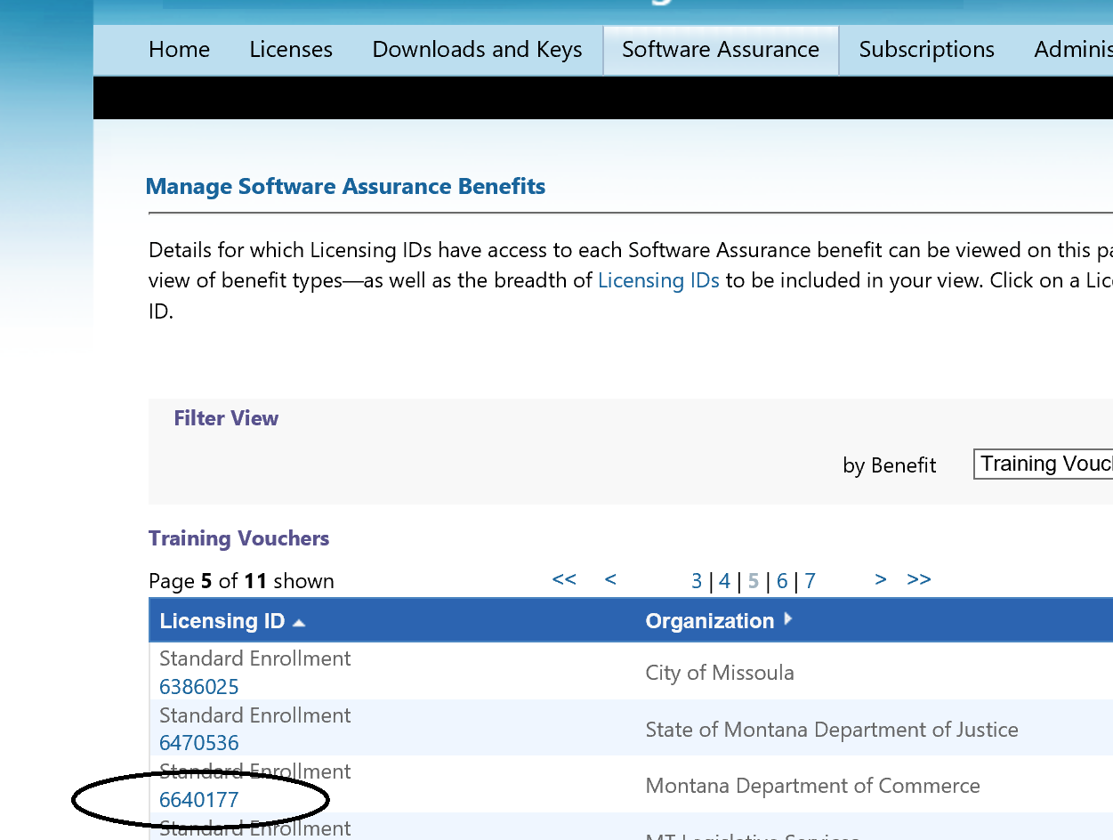
Select the appropriate ID

Slide 10
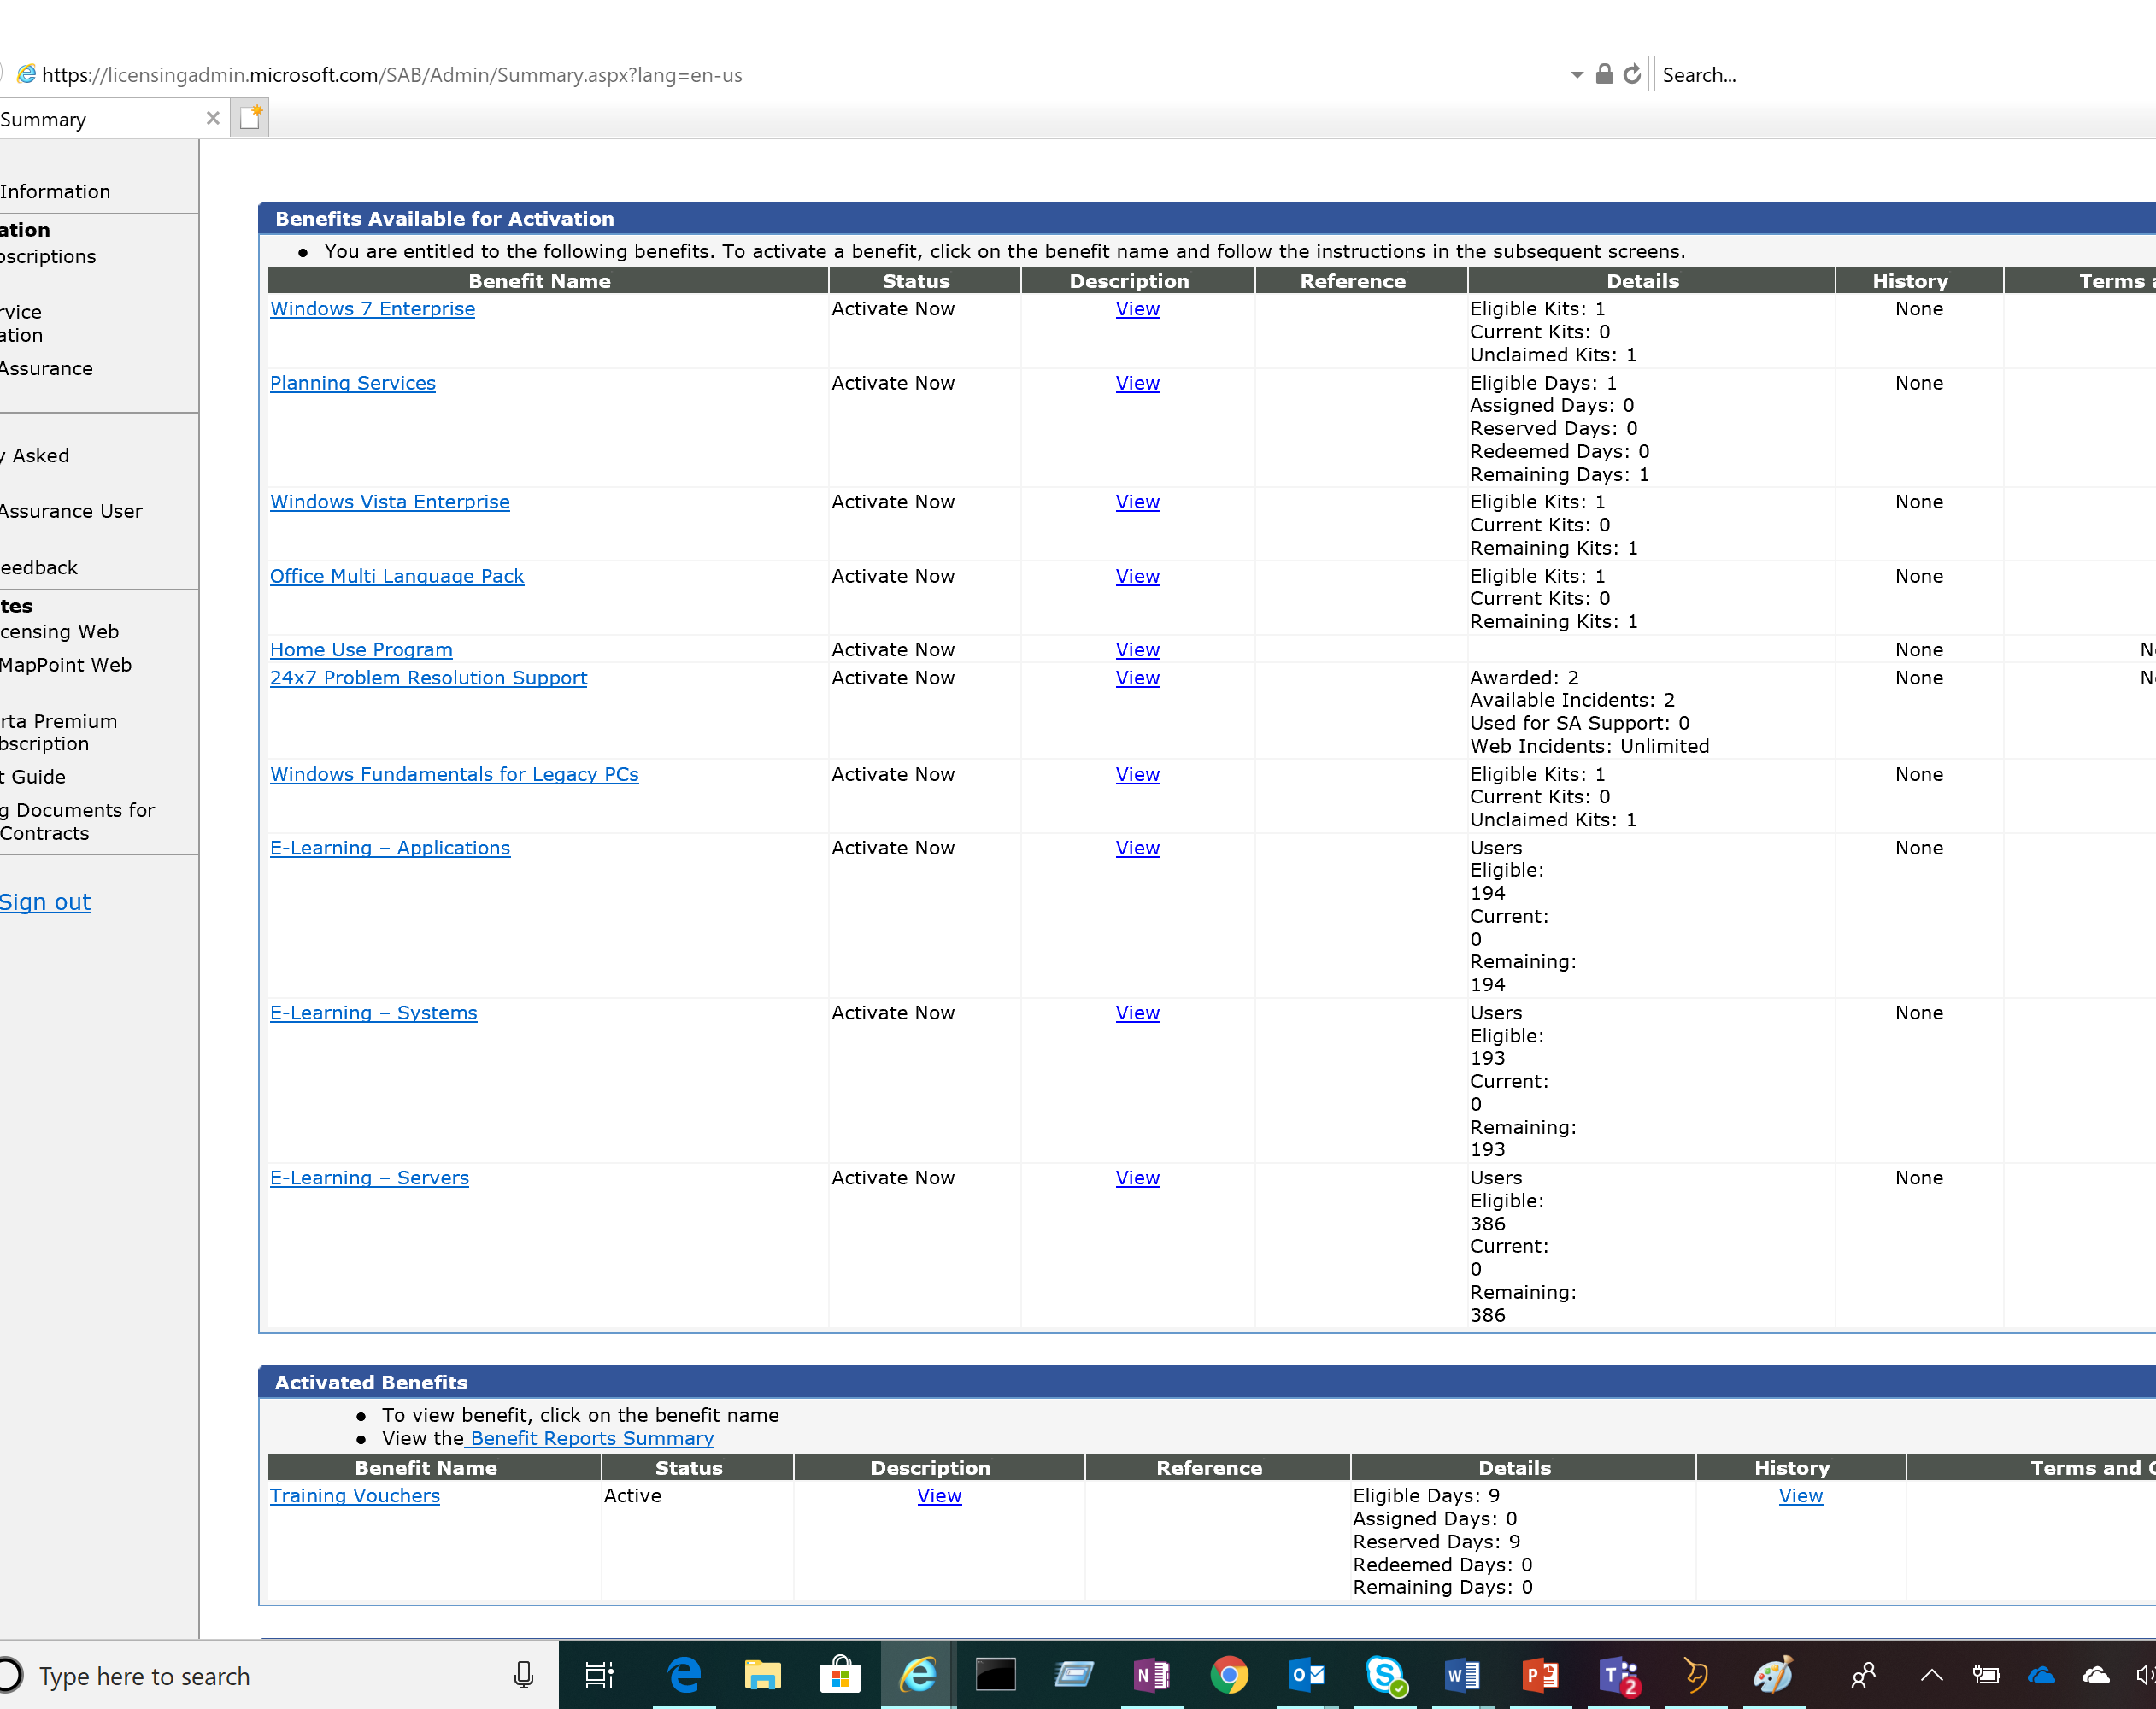
Select Training Vouchers
All your benefits are visible on this page

Slide 11
Select Create Voucher
If they are not Active you will have to select Activate
Add Trainee information
Select number of days
Select Add Voucher
When all current request are created Select Submit Voucher List
Trainee should receive a email confirming the allocation

Slide 12
Questions
Breanne Antonius
Email: Breanne.Antonius@microsoft.com
Phone: (503)889-9202
Donald Scott
Email: Donscott@microsoft.com
Phone: (210)849-2196
Reseller

Slide 13
Resources
Product Terms
https://www.microsoft.com/en-us/Licensing/product-licensing/products.aspx
Volume Licensing site
https://www.microsoft.com/licensing/servicecenter/default.aspx
Training providers
https://www.microsoft.com/en-us/learning/partners.aspx
VLSC Software Assurance Guide
http://download.microsoft.com/download/A/7/D/A7D04694-1B1E-4B18-918F-0EDCD43BA2E5/VLSC-Software-Assurance-Guide_en-US.pdf

