Slide 1
Proposed IT Classification Changes
State Human Resources Occupational benchmarking updates and their impact to IT Roles.

Slide 2
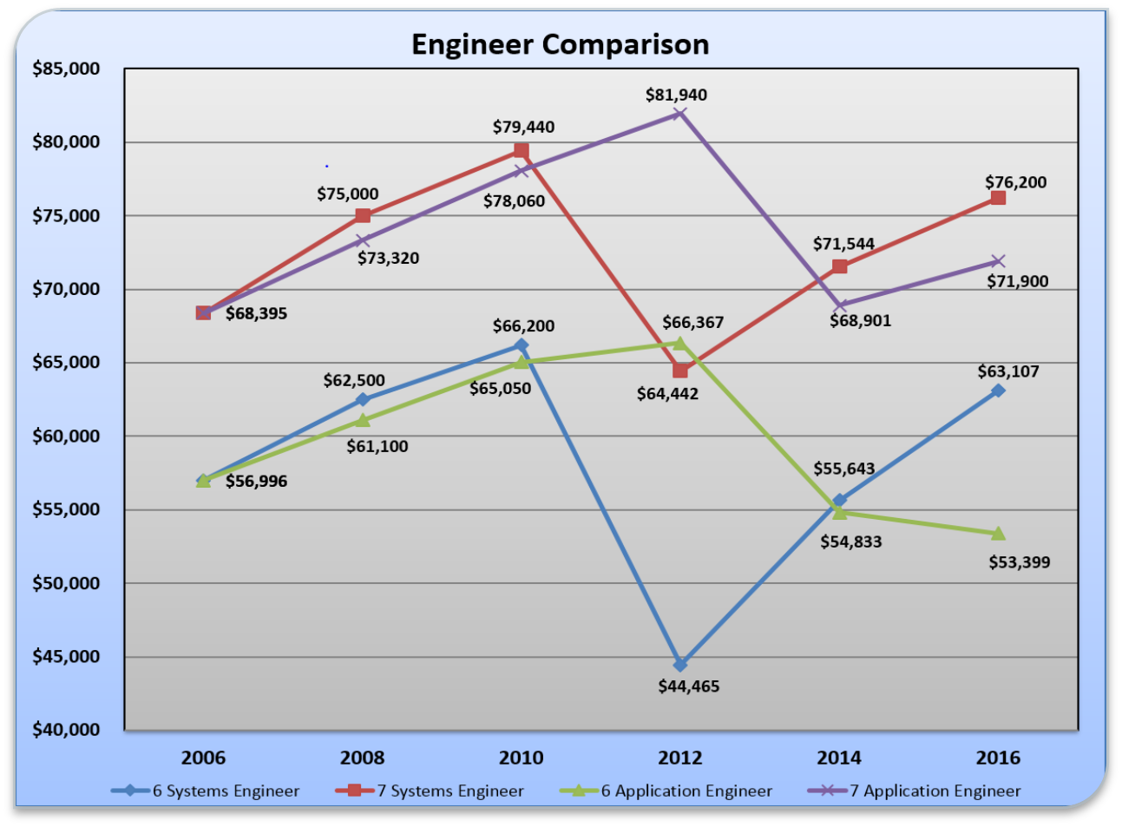
Engineer Market Crash of 2012
Market salary volatility forces significant classification changes In SITSD to retain key contributors…

Slide 3
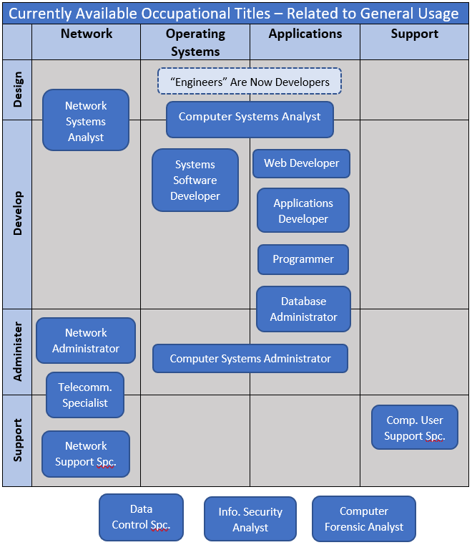
Current State of Occupational Titles
A Landscape of gaps and redundancies when applied to core IT functions!

Slide 4
Proposed “Parent” Benchmarks applied to Functional Areas OF IT

Slide 5
Example “Developer” Benchmark

Slide 6
State HR Disclaimer…..
QUESTIONS???

