Slide 1
Enterprise approach to Email SPAM
False Positive Spam
Unsolicited
Advertisements
Phishing Scams
Trojan Horse Email
Chain Letters
Email Spoofing
Political or Terrorist Spam

Slide 2
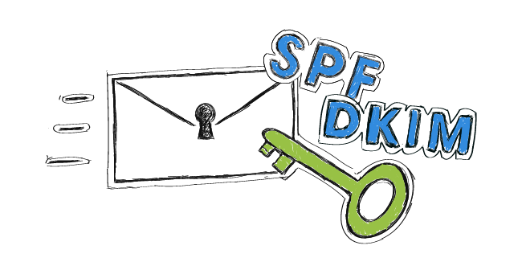
Definitions:
SPAM Filter
A spam filter is a program that is used to detect unsolicited and unwanted email and prevent those messages from getting to a user's inbox. Like other types of filtering programs, a spam filter looks for certain criteria on which it bases judgments.
SPF Record
A Sender Policy Framework (SPF) record is a type of Domain Name System (DNS) record that can help to prevent email address forgery. ... Adding an SPF record can help prevent others from spoofing your domain. You can specify which mail servers are permitted to send email on behalf of your domain.
DMARC
DMARC (Domain-based Message Authentication, Reporting and Conformance) is an email-validation system designed to detect and prevent email spoofing, the use of forged sender addresses often used in phishing and email spam.
DKIM
Domain Keys Identified Mail (DKIM) allows senders to associate a domain name with an email message, thus vouching for its authenticity. A sender creates the DKIM by “signing” the email with a digital signature. This “signature” is located in the message's header.
X-header
X-headers are non-standard headers that are added to the header collection of an email to communicate information. For example, Exchange stamps messages with the X-MS-Exchange-Organization-SCL header to indicate the spam confidence level (SCL) attributed to the email.
WhiteListing
Spam filters often include the ability to "whitelist" certain sender IP addresses, email addresses or domain names to protect their email from being rejected or sent to a junk mail folder.
False-Positive
Legitimate email misclassified as spam or malware due to incorrect configuration on the senders behalf.
False-Negative
Potentially malicious email not detected by the system due to the current aggressiveness of the applied policies.

Slide 3
SPAM Confidence Levels:
SCL Rating | Spam Confidence Interpretation | MT.GOV Action
-1 | Non-Spam coming from safe sender, safe recipient, or safe listed IP address (trusted Partner) | Deliver the message to the recipient's mailbox
0,1 | Non-Spam because the message was scanned and determined to be clean | Deliver the message to the recipient's mailbox
5,6 | Spam | Quarantine
7,8,9 | High confidence spam | Delete
When an email message goes through spam filtering it is assigned a spam score. That score is mapped to an individual Spam Confidence Level (SCL) rating and stamped in an X-header. The service takes actions upon the messages depending upon the spam confidence interpretation of the SCL rating. The table shows how the different SCL ratings are interpreted by the filters and the action that is taken on inbound messages for each rating.
SCL ratings of 2,3,4,7, and 8 are not set by the service. An SCL rating of 5 or 6 is considered suspected spam, which is less certain to be spam than an SCL rating of 9, which is considered certain spam.

Slide 4
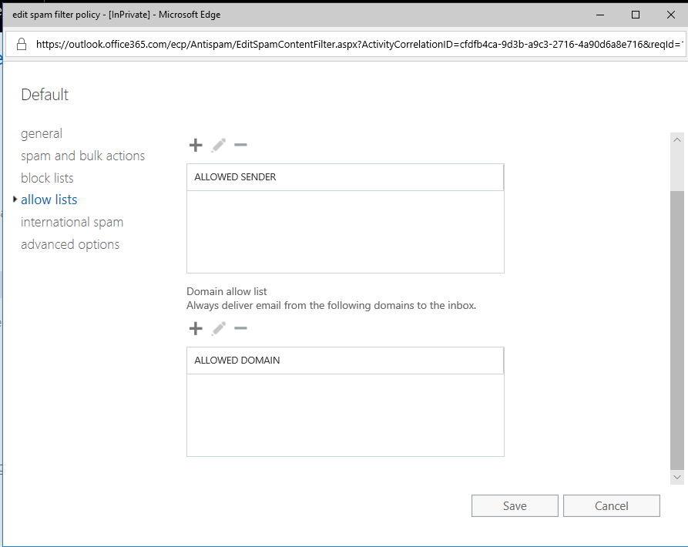
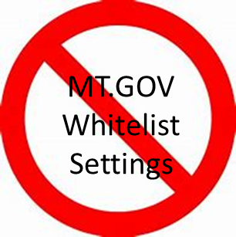

Slide 5
Links
Link to view user accessible quarantine
https://protection.office.com/?hash=/quarantine
NMG ITPro Exchange SPAM FAQ
https://mtgov.sharepoint.com/sites/ent-sitsd/NMG/ITPro/SitePages/Exchange%20Spam%20FAQ.aspx
“The State of Montana does not allow white lists (also known as safe sender lists) as this would cause all email messages from that sender to be trusted regardless of content or originating server.
If we were to “white list” a user or domain (say bob@builder.com or his domain builder.com), then anyone could send e-mails claiming to be bob@builder.com or another user from that domain. Every e-mail sent (from bob or anyone pretending to be them) would be allowed because they are "white listed". Alternatively it's possible bob@builder.com themself could get compromised and start sending spam, phishing, or malicious e-mails. When you white list a user or domain any e-mail matching that sender from any source, legitimate or malicious, bypasses spam filters, anti-phishing filters, and in some cases even attachment scanning and malware filters. Further, if we whitelist bob@builder.com then anyone pretending to be them would be able to send e-mail to any recipient we host mail for, not just a select group wanting the whitelist.
A good analogy to understand why whitelisting is an unsecure practice is like your bank debit card. You write "see ID" on your card because you want anyone using the card to have to proove they are you, you want to keep your bank information and money secure. Whitelisting would then be like asking the bank to allowing anyone who walks up and shows any ID regardless of who they are to be able to access your bank information or money.”
https://www.spamstopshere.com/blog/email-security/whitelist-dangers-and-cyber-security
“If your antispam program encourages you to use whitelists, it probably has to rely on that to compensate for a high false positive rate. That's a bad thing, because whitelisting introduces new security risks.”
https://searchsecurity.techtarget.com/answer/Will-using-whitelists-and-blacklists-effectively-stop-spam
"Creating either list is time-consuming, but a white-listed sender's system, in particular, can easily be compromised. Should this happen, your email system would allow spam from the mail server until the sender from the whitelist is removed."
https://www.emailage.com/corporate-domains-whitelisting/
“You should never blindly trust corporate domains, simply because they can be exploited by fraudsters just like regular webmail domains.”
https://oit.williams.edu/help-docs/why-oit-does-not-whitelist-domains/
"Whitelisting means making an exception to the rules that allows all mail to come in from a site without being checked. This circumvents our protection and opens us up to any problems on site XYZ. It is better to let the anti-spam appliance do its job and keep the protection that it offers."

Slide 6
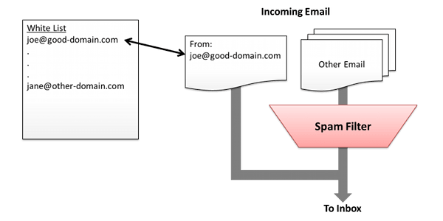
From SPAMSTOPSHERE
What does it mean to Whitelist?
Whitelisting bypasses:
Anti-phishing
Anti-spoofing
Anti-malware
Anti-virus

Slide 7
Monthly Mail Report Available in Splunk
Month | Year | Good Mail | Spam | Malware | Spoof Mail | Blocked Incoming Rules | ATP Blocked | Sent Mail | Outbound Spam | Blocked Out Rules | InboundDLP | OutboundDLP
January | 2019 | 5,457,354 | 1,577,700 | 1,636 | 2,116,778 | 182,402 | 849 | 1,270,858 | 21,280 | 2,091 | 966 | 176
Good Mail - All Incoming mail that passes spam, malware, ATP Checks, and transport rules. Spam - Incoming messages caught by EOP spam filters. (Quarantined) Malware - Incoming messages caught by EOP Malware filters (Admin Quarantine) Spoof Mail - Incoming messages caught by EOP for having invalid or no DKIM/SPF records (Admin Quarantine) Blocked Incoming Rules - Incoming Messages blocked by transport rules. (Deleted) ATP Blocked - Incoming Messages blocked by Exchange ATP. (Deleted) Sent Mail - All outgoing mail that passes the outbound spam filters and transport rules. (Delivered as regular email) Outbound Spam - Outgoing messages that are detected as possible spam. (Delivered as regular email) Blocked Out Rules - Outgoing messages blocked by transport rules. (Deleted) Inbound DLP - Incoming messages that meet DLP Rules (No action taken on these messages) Outbound DLP - Outgoing messages that meet DLP Rules. Messages from Exchange are blocked and an NDR sent to the user. Messages sent through the SMTP service are encrypted and sent.

Slide 8
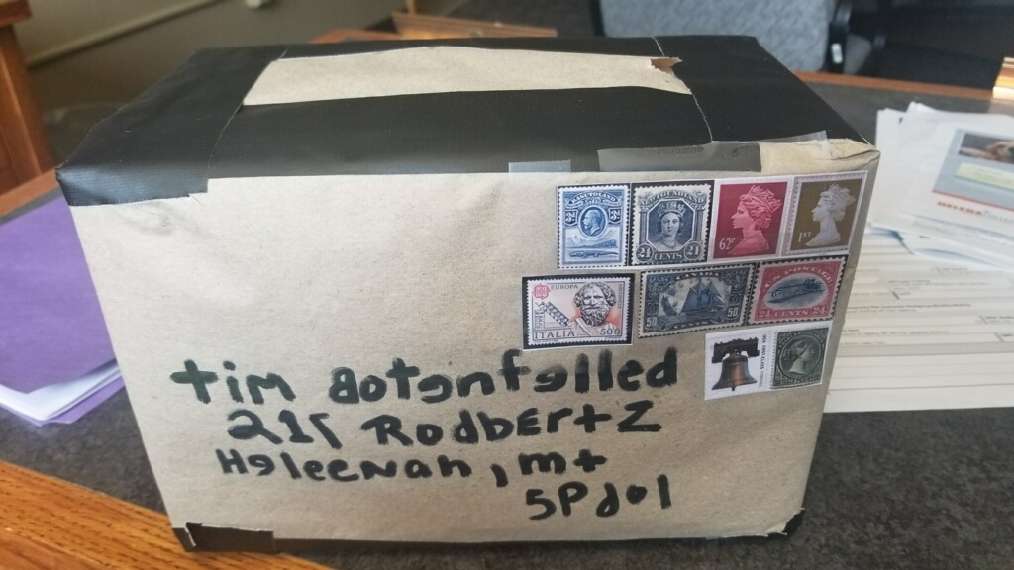
Questions
Would you open this?

