Slide 1
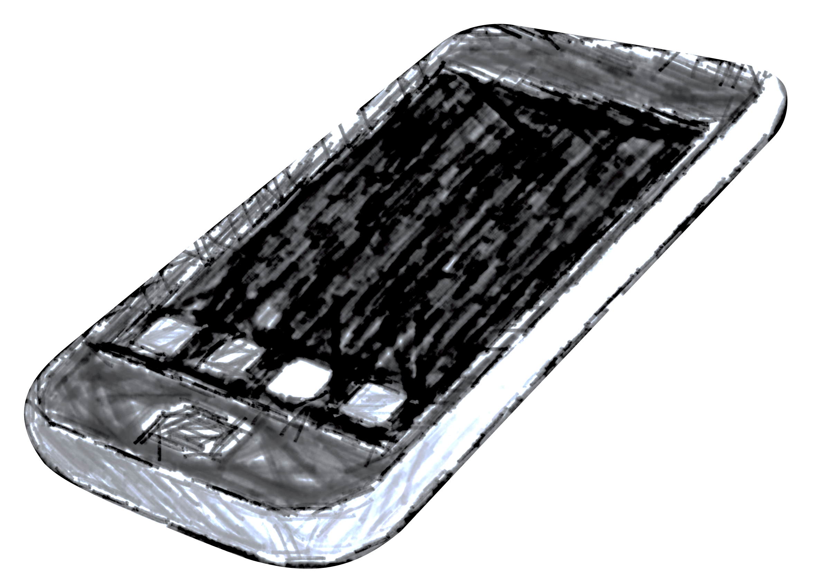
AVAYA Web Text
Enabling your call center with SMS/MMS texting

Slide 2
Why Text?
COMMUNICATION PREFERENCES OF PEOPLE ARE CONSTANTLY CHANGING, IN PERSON, CALL, EMAIL, TEXT, im
WE ARE CURRENTLY SET UP TO MOVE TOWARD A TRUE CONTACT CENTER, AVAYA AURA CONTACT CENTER (AACC)
WEB TEXT IS THE ONLY COMPANY TO FULLY INTEGRATE WITH EVERY AACC PLATFORM.

Slide 3
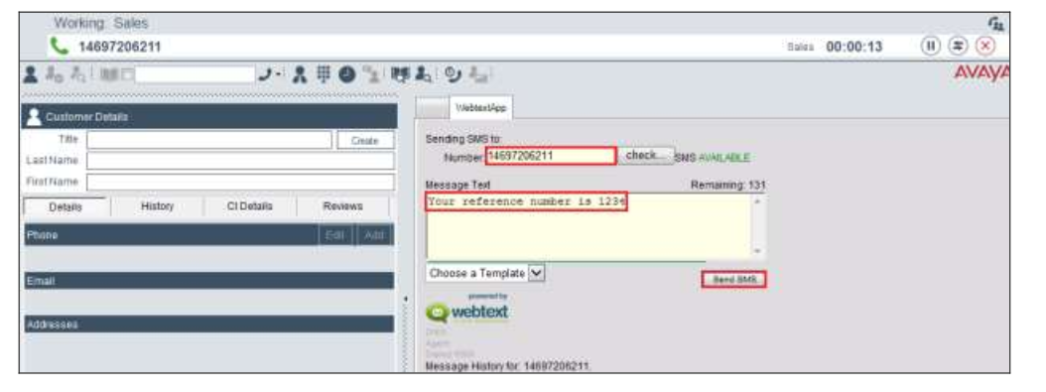
Display the call centers 888 number as the sender (not your personal number)
888-706-1535

Slide 4
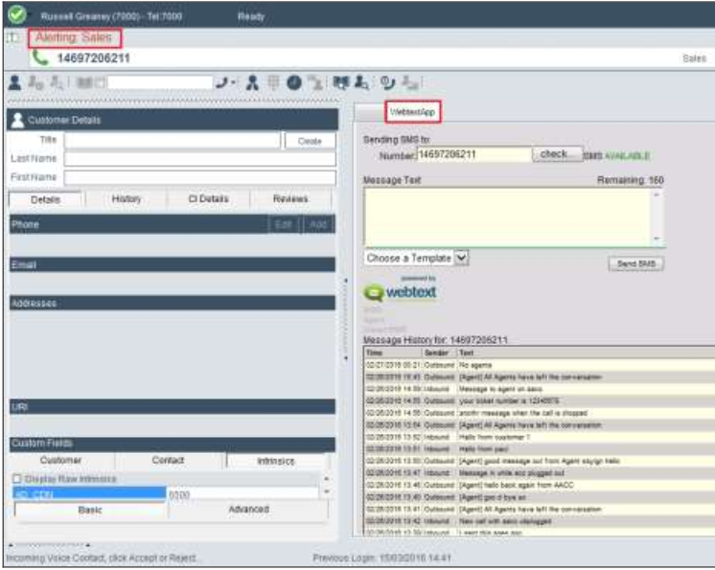
Incoming contact can be text only instead of a call
SAVES TIME AND MONEY
CUT DOWN ON INCOMING 800 NUMBER COSTS
NO WAITING IN THE QUE FOR ENDLESS HOURS

Slide 5
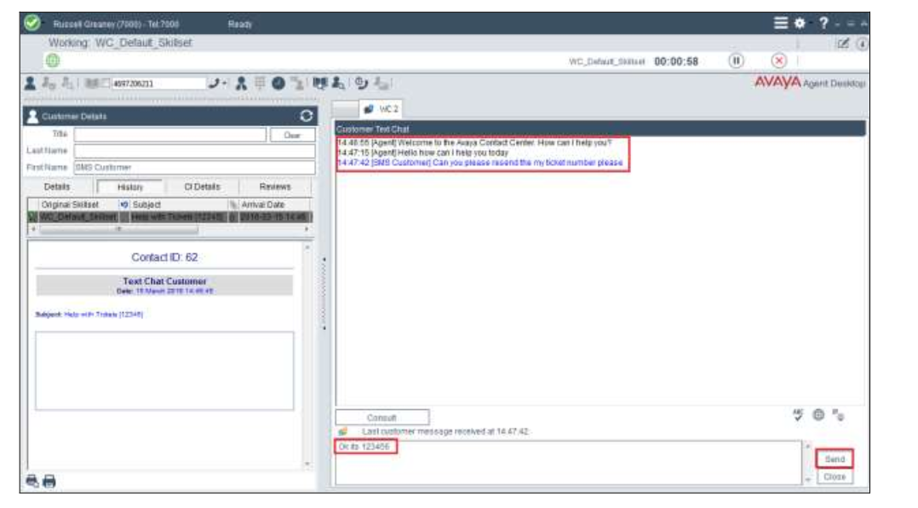
Agents are able to handle multiple contacts at the same time from the current client they are using today
Incoming call
SMS text
Email

Slide 6
Topology
We are 95% there just need web server deployed

Slide 7
Web Text Cost Model (Estimate ONLY)
 | DIDs | Annual Cost | Annual cost per DID | Cost | Monthly Cost per DID | Texts included | Texts included (Per DID) | Cost Per Text
Recurring Cost | 100 | $24,000.00 | $240.00 |  | $20.00 | 480000 | 4800 | $0.0500
Example 5M Texts |  | $39,000.00 |  |  |  | 5000000 |  | $0.0078
TOTAL |  | $63,000.00 | $630.00 |  | $52.50 | 5480000 | 54800 | $0.0115
Recurring Cost | 100 | $24,000.00 | $240.00 |  | $20.00 | 480000 | 4800 | $0.0500
Example 3M Texts |  | $25,200.00 |  |  |  | 3000000 |  | $0.0084
TOTAL |  | $49,200.00 | $492.00 |  | $41.00 | 3480000 | 34800 | $0.0141
Recurring Cost | 100 | $24,000.00 | $240.00 |  | $20.00 | 480000 | 4800 | $0.0500
Example 1M Texts |  | $9,000.00 |  |  |  | 1000000 |  | $0.0090
TOTAL |  | $33,000.00 | $330.00 |  | $27.50 | 1480000 | 14800 | $0.0223
One Time Cost |  |  | $57.50 | $11,500.00 | $4.79
Tier 1 |  |  |  |  |  | 0-3M |  | 0.009
Tier 2 |  |  |  |  |  | 3M-5M |  | 0.0084
Tier 3 |  |  |  |  |  | 5M+ |  | 0.0078

Slide 8
Video Conferencing
SITSD – SummitNet Video Conferencing

Slide 9
Current SITSD Catalog Offering For VTC Services
Video Conferencing Managed Bridge Service, Unlimited
Price: $331.50 per month per location, plus AD and Remote/Campus Access Charge for each endpoint
Services Include
Access to Virtual Meeting Rooms on Polycom RMX Bridge (SFB, Voice, and H.323 Video)
Access to Virtual Recording Rooms on Polycom RMX Bridge
ISP Streaming capability available with Virtual Recording Rooms
Managed Multi-Tenant Global Directory
Firewall Traversal Services for external H.323 locations
128 Bit AES Encryption
QoS tagging for video traffic priority
ISDN Connectivity for federal locations
Management and Configuration Assistance
SITSD Support
10 Polycom Desktop RealPresence licenses per contract

Slide 10
SITSD/SVN Video Conference Endpoint Hardware
Polycom Group Series Codecs
The Polycom Group Hardware Codec is the current recommended solution for State Video Customers
H.323 is the current protocol used with the Polycom systems
The Polycom Group Series can be dual stacked and have native registration to our H.323 Network and our Skype For Business environment
Avaya integration is also available for dial tone over the Polycom systems
Currently agencies are responsible for procurement and maintenance of their Polycom deployments
SITSD currently has a video contract with AVI Systems based out of Bismarck, ND that is available to our agencies (local presence in Billings, MT).
There are currently 106 Polycom Group Series on the State Video Network
Other Polycom Hardware Codecs currently on the SITSD/SVN Network
Polycom HDX series: Series of codecs previous to the Group series – 99 on the network
Polycom VSX series: Series of codecs previous to the HDX series – 27 on the network (EOL/EOS)
Polycom ViewStation series: Series of codecs previous to the VSX series – 5 on the network (EOL/EOS)

Slide 11
SITSD/SVN Video Conference Endpoint Software
Polycom RealPresence Desktop
Polycom RealPresence Desktop is available to our State Video Contract subscribers
Licenses are managed and subscribed by the State Polycom RealPresence Resource Manager
Licenses can extend outside the State Network with the Polycom RPAD Firewall Traversal Unit
Licenses are reclaimed after two weeks of inactivity
State Active Directory integration (Single Sign-On)
Software application is heavily utilized primarily by Supreme Court Admin, Corrections, and OPD
Polycom RealPresence Mobile
A free mobile phone application available through Apple and Google Play store
SITSD does not register/integrate this solution directly back to the State Video Network
Stand alone application on mobile devices that dials through our public IP address on our Polycom RPAD Firewall Traversal Unit
Heavily utilized by Supreme Court Admin (District Courts)

Slide 12
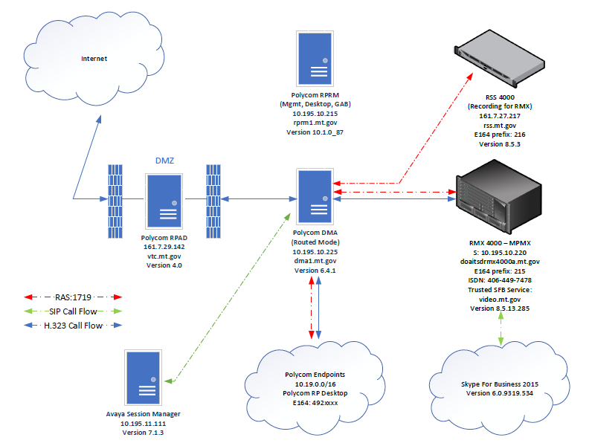
SITSD/SVN Video Conferencing Infrastructure

Slide 13
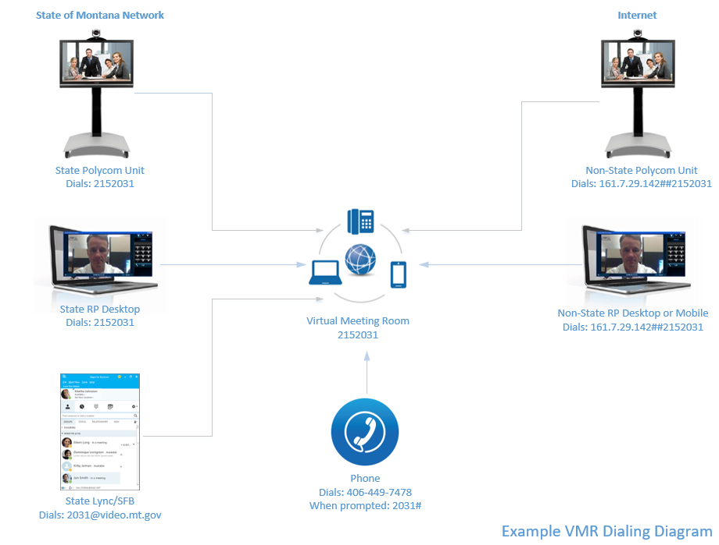
Virtual Meeting Room Dialing Diagram

Slide 14
Future of State Video…Zoom Communications
Leader in the 2018 Gartner Magic Quadrant for Meeting Solutions
Integrates with Skype For Business, Current State H.323 Network (Polycom), Microsoft Teams, and State Avaya Voice
Software based (non-proprietary stance on hardware)
Application based compatibility on PCs, Macs, Android, and IOS
WebRTC (Google Chrome) – no downloads for full feature video/web conferencing
Streaming and Recording
Large ad hoc web conferencing (500 participants)
Desktop sharing with full motion video/audio (Easy local and remote display with annotation)
AD Integration
Exchange calendar invitation plugin - links for H.323, WebRTC URL, Skype For Business, and Voice Call In
All positive feedback during recent demo phase

