Slide 1
Confidentiality Notice
This presentation is Confidential Information under the nondisclosure agreement between your company and Microsoft. It is for discussion purposes only, subject to change, and should not be interpreted as a binding agreement or commitment on the part of Microsoft.

Slide 2
Microsoft Unified Support
Performance

Slide 3

Deliver personal, immersive experiences across devices
You think about
technology differently
Encourage agility and innovation across the business
Improve access to data and tools
across entire environment
Reduce costs and refocus IT efforts beyond infrastructure
and operations
Respond faster to take on new opportunities
To achieve digital transformation, your technology must help you evolve how you
do business
Connect employees with
real-time customer insight

Slide 4

So we’ve transformed our support to fuel your innovation
From a packaged software model…
Based on allocated support hours
Annual or multi-year agreements
Fixed capacity
Predefined scope of services for the year
…to a cloud services model
Based on product spend
Annual agreement with price protection
As-needed support with on-demand tools and resources
Foundational support with Add-ons to purchase any time
What does this mean for you?
By aligning to how you purchase and use technology we can better match your support needs, today and tomorrow
As-needed, organization-wide support coverage
Support aligned to your Microsoft investment
Single support contract for your entire Microsoft portfolio
Continuous updates to your support services
Modern, digital support experiences

Slide 5
Introducing Microsoft Unified Support
Designed to help you get the most value from your Microsoft investment
Industry-aligned pricing as a percentage of your Microsoft product spend
As-needed 24x7 organization-wide problem resolution for all Microsoft technologies
Add-on services designed to further customize your experience and meet unique requirements
Built-in Proactive Services
to enable key outcomes around implementation, security, and optimization
Digital experiences via Services Hub where you can build skills, manage risks, and gain insights
Microsoft Confidential

Slide 6

The promise of modern support
Comprehensive support that covers your entire organization
Microsoft Unified Support was built around four foundational pillars:
Access to as-needed support
Organization-wide coverage
Outcome-driven service delivery management
Faster connection through digital experiences
1
2
3
4
We have found that Unified Support aligns very well with our strategy to move towards a cloud first environment. It gives us the flexibility plus all the support we need to ensure that our cloud strategy requirements are satisfied.
Faheem Mashadi, Manager, Infrastructure & Applications Support, Metrolinx

Slide 7

What you get from this modern support experience

Slide 8

Expanded coverage to focus on outcomes,
not hours
In the past
You estimated and purchased a set number of reactive support hours for the upcoming year
Underestimating may have forced you to ration support hours or debate where hours were most needed
When you’re no longer limited by hours, you can focus on what’s next
In Microsoft Unified Support
Problem resolution is available to your entire State as needed
No contractual limitations get in the way of Microsoft helping you resolve issues quickly
You save time, money, and resources to drive better productivity, collaboration, and innovation with your Microsoft investment

Slide 9

Comprehensive support for a strong foundation
Addressing your common, ongoing needs with reliable reactive and Microsoft-led experiences
Transformative experiences built into Base Support
24x7, as-needed, and organization-wide problem resolution covering your technologies, end users, and IT
30-minute response times for critical issues with priority handling for all incidents
Built-in Proactive Services to help drive technology adoption, security, and operations initiatives
Support Technology Advisor service providing tailored assistance and guidance to optimize cloud projects
Available onsite support when you need it

Slide 10
Built-in Proactive Services
Focused services you know, now built into your foundational experience as part of Base Support
Areas of focus
Technology adoption
Adopt a new technology or feature
Focus technologies: Microsoft Azure, Office 365, Windows 10, SQL Server
Security
Improve the security posture of your environment Focus technologies: Active Directory, Windows 10
Operations optimization
Improve service management and operational processes Focus technologies: Microsoft Azure, Office 365
Key outcomes for your organization
Identifies and prevents possible future support issues
Expands IT’s technical confidence
Expedites project setup plus validation from Proof of Concept
Improves operational processes and helps reduces costs

Slide 11
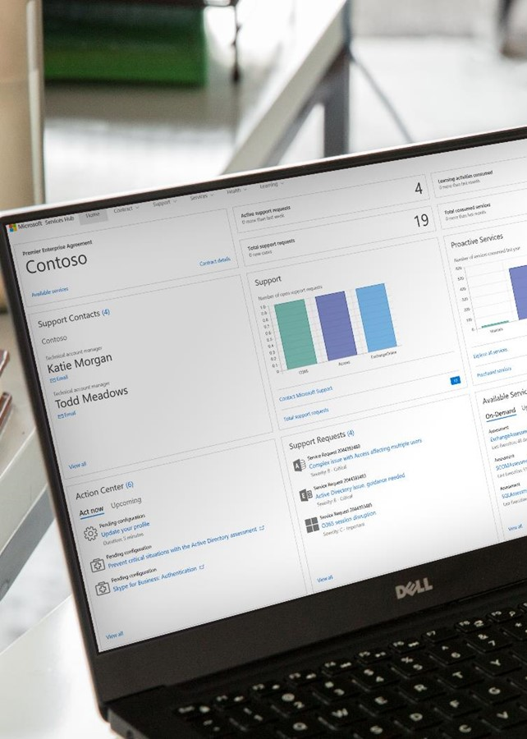
A new digital experience via
one central hub
Convenient, self-service tools and training to empower IT and optimize support efforts
Mitigate risks by leveraging expert Microsoft guidance
and recommendations
Proactively manage the health of your environments with on-demand assessments
Improve IT staff competency with access to all Microsoft on-demand education
Maximize your support benefits with access to your support contract details and available services
Take advantage of new capabilities and plan for product changes through the Update Center
Services Hub helps you connect with the resources you need
Access the latest technical and expert guidance anywhere you go
Easily locate Microsoft support services and proactive IP content
Quickly find contact information for your Microsoft account managers and manage support access
Notes:
up skilled resources to work on them

Slide 12







A closer look at Services Hub features
Dashboard
Contract Details
IT Environment Health
Learn
On-demand
Services Catalog
Update Center
Support
Convenient self-serve experience allows you to optimize how you spend your time
Take action on risks and issues that may impact your IT environment
View your support and services trends by product to stay in the know
Review upcoming training and services in your area
Know your contract details and service benefits
Review your Microsoft contract description and entitlement of your support and services
View a summary of the support you’ve purchased
Quickly find key Microsoft contacts in one place
Keep your IT environments healthy with on-demand assessments
Proactively manage your IT environment health with predictive analytics based on expert Microsoft analysis
Drill into root cause information with easy-to-understand recommendations
Configure once and run on demand on your schedule
Stay current on your technologies with unique learning experiences
Learn anytime, anywhere, on any device
Participate in live instructor-led webcasts and learn on your own with self-paced learning paths
Access to all on-demand learning experiences such as videos and virtual hands-on labs
Easy to manage your Microsoft support activity
View your support request data and support requests trends
As a support contact, manage your support Access ID and password online for request management
Easily toggle who can open support requests online as an administrator
Save time to connect to the services you need
View the latest Microsoft Services catalog online
Check seat availability for workshops and online courses
Click to contact Microsoft to reserve seats or schedule a new Microsoft Service
Stay connected and current with
product updates
Discover new and updated Office 365 and Azure information online
Follow products for changes in release information
Sign up for events to learn more about Office 365 and Azure services

Slide 13
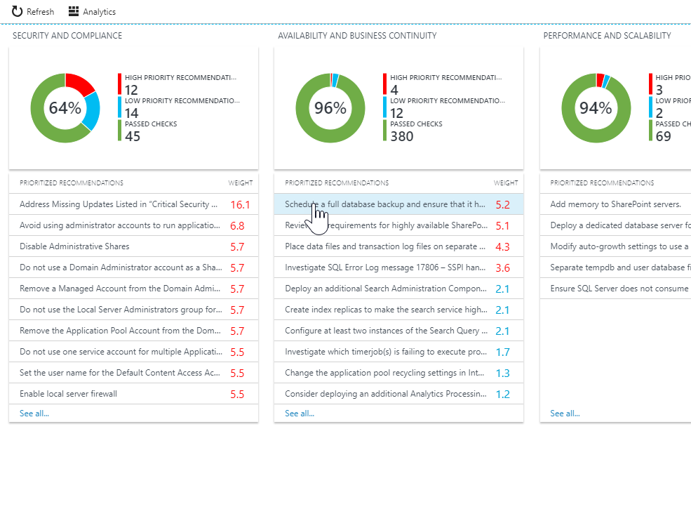
Service Hub highlight: On-demand assessments
Keep your IT environments healthy
with on-demand assessments
Proactively manage your environment health with predictive analytics based on expert Microsoft analysis
Drill into root cause information with easy-to-understand recommendations
Configure once and run on demand on your schedule
Microsoft Confidential

Slide 14
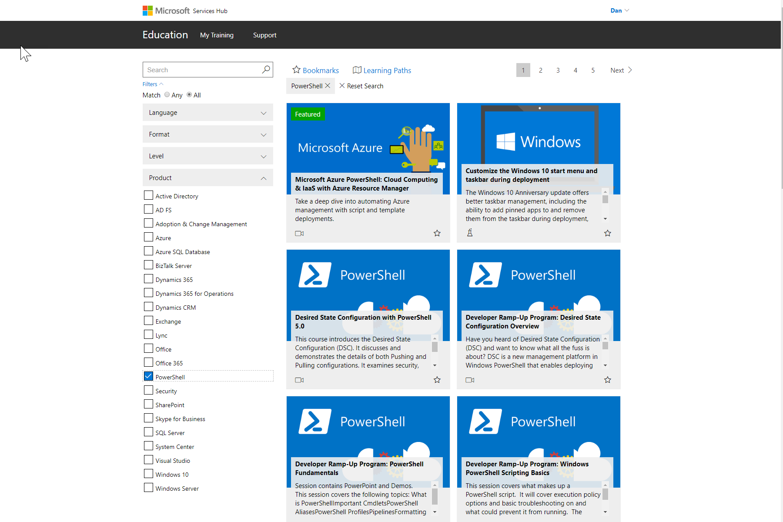
Service Hub highlight: On-demand learning
Improve your team’s knowledge with Microsoft on-demand learning
Learn anytime, anywhere, on any device
Access a variety of learning experiences such as videos and virtual hands-on labs
Join live instructor-led webcasts or learn on your own with self-faced learning paths

Slide 15

A strategic partner to help you achieve more
“Within a couple of weeks, my TAM told me all of the possible solutions I was looking for would be available for production in the next couple of weeks... I was able to provide feedback, I was heard, and got exactly what I was looking for.”
Sean Mackey-Marcella,
IT Manager, City of Vaughn, Ontario, Canada
Your designated, go-to expert and advocate within Microsoft who’s focused on maximizing outcomes
and supporting what’s next
Develop Strategy
Taking the TAM experience you know…
Offering an account manager who knows your objectives at a divisional level and advocates for
you based on hours defined in Premier contract
…and expanding it for greater impact
Providing broad focus across organization to ensure you get the most from Base Support
Facilitating collaboration and business impact through Proactive Services
Helping ensure you quickly realize value from your new support

Slide 16
Add-ons to further customize your experience
Two types of Add-ons: Short-term engagements and end-to-end solutions
Where Base Support provides a strong foundation for your support experience, Add-ons are designed to drive the technology and business outcomes you need most.
You can always add new Add-ons to your contract as your support needs change.
Proactive Services
An extensive catalog of services to help you successfully plan for future projects, implement new technologies faster, maintain a healthy environment, and expand your technical knowledge base to increase IT’s value to the organization
Enhanced Solutions
Technology-specific, in-depth support designed to help solve your organization’s most complex IT challenges, with these areas of focus:
Full Care
Performance Drivers
Development Support
Cloud Services Management
Engineering Experiences
Notes:
There are two key components to your new support experience: Base Support that automatically covers your most common needs, and add-on support services that deepen your engagement experience, giving you the agility to adapt solution-oriented services that align with your unique requirements. When combined together, these services provide a complete support services experience that enables you to fully realize the potential of your Microsoft solutions.

Slide 17

Performance Support
Personalized to maximize business outcomes

Slide 18
Enterprise-grade support at each step of your journey
Performance offers our highest level of support for your Microsoft products and services. This tailored, relationship-based support experience comes with access to our fastest response times and deep technical expertise–ensuring your technology solutions operate at top levels of reliability, performance, and availability.
The result is a support experience centered around you
Get total coverage for all your Microsoft technologies through 24x7, as-needed problem resolution
Maintain business continuity with
30-minute response times on critical issues with priority handling for all incidents
Leverage a Technical Account Manager who understands your goals and serves as your advocate
Optimize your cloud projects with a Support Technology Advisor service that aligns resources to your goals for a cloud or identity workload
Customize your experience with available onsite support when you need it
Expand your IT staff’s value to the business–and mitigate potential risks to your environment–with a vast collection of on-demand trainings and self-service health assessments
Notes:
Why does the new support make sense for businesses like yours?
The new support offers the best support possible for your Microsoft products and services. Microsoft assembles a team of the right people to support you, putting them onsite when needed. With a deep, dedicated understanding of the solutions that drive your business, Microsoft takes a proactive approach to ensuring your systems are operating at top levels of reliability, performance, and availability.
How we support you and deliver optimized support
Service Delivery Management (SDM) is a key part of our support evolution, with services in the new support called out by outcome and cadence, rather than constrained by hours available or remaining. We accomplish this in three ways:
Services Hub – Your go-to online location for everything related to your support, the Services Hub allows you to maximize the value of your Microsoft investment, access the latest technical guidance anywhere you go, and prevent issues with expert guidance. In the Services Hub, you can access:
Your support services and dashboard
Your contract benefits
On-demand assessments
As-needed on-demand learning
The Microsoft Support Services Catalog
Microsoft Office 365 Update Center
Technical Account Manager (TAM) – Your designated, go-to expert and advocate within Microsoft, your TAM understands your business, your goals, and how to connect and use Microsoft services, tools, and resources to help you meet those goals. Your TAM helps ensure:
Your entire organization is covered
You quickly realize value from your new support in multiple ways (reactive, proactive, and self-service)
Support Technology Advisor (STA) – Aligning Microsoft resources to help you achieve key outcomes, the STA service helps you create a Support Technical Plan for a chosen cloud or identity workload and helps orchestrate its execution.
The result is a support experience centered around you
Replacing an hours-based model with as-needed problem resolution across all Microsoft technologies to help you drive desired business outcomes.
Delivery-led embedded services foster joint understanding and collaboration between TAMs and customers, helping us better support customers’ key technology initiatives and insert support services that drive cloud adoption and customer success.
The rich digital tools and experiences available in the Services Hub enable customers to be more self-sufficient while allowing us to modernize and extend our interactions with customers.
Continually evaluating how we deliver certain support components leveraging pooled resources and self-service capabilities–specifically related to each customer’s industry, businesses, objectives, and cloud aspirations–will help us improve and expand customer relationships.

Slide 19
Driving additional value for your organization
The Support Technology Advisor (STA) service aligns Microsoft resources to help you achieve key outcomes for your chosen cloud or identity workload.
  Providing strategic support recommendations to help achieve your key objectives
  Supporting cloud growth, innovation, and competitive advantage by optimizing
  your selected cloud
  or identity workload
OUR ROLE IN YOUR CLOUD SUCCESS
  Assessing your cloud process maturity level and readiness to help you pursue excellence in your chosen workload
  Expanding cloud effectiveness by mapping your leadership goals with technology

Slide 20
A closer look at the support services you’ll gain
 | Base Support features
Problem Resolution Priority handling for all incidents | Response times: 30-min for critical with priority routing (24x7) 4-hour for standard (24x7) Immediate Critical Situation Manager assignment Priority routing to Microsoft's experienced technical specialists Outcome-focused support services tailored to customer needs Relationship-based and personalized support through Services Delivery Management (SDM) Designated technical expert to lead support planning for critical workloads through the Support Technology Advisory (STA) Service
Preventative Support Strategic recommendations that remediate and prevent risks | Access to a wide variety of service delivery management support services and resources to help drive your success in the Cloud Access to support assistance from product experts to optimize operations
Planning Assistance Business-aligned support plans validated against the customer objectives | Assigned Technical Account Manager (TAM) who understands their goals and can align key assets and resources In-depth planning engagement led the STA service for their chosen cloud or identity workload Regular reviews and action tracking for strategic IT projects Review of upcoming features and changes to online services with available insights on the impact to your IT
Implementation Support Microsoft-led implementation support | STA and account team jointly working for your cloud success Support planning and optimization engagement Access to support assistance from product experts to accelerate technology adoption and improve security and performance for key workloads
Support Personalization Support tailored to your specific business and technical needs | STA service provides a Support Technical Plan with strategic recommendations to help sustain the business Customized support plans with your choice of support services
Notes:
Value of Base Support features
Personalized support: Relationship-based, customized, increased depth of knowledge
Fastest response to incidents with immediate access to deepest technical expertise
Named technical contact from Microsoft
Outcome-focused support services tailored to customer needs that helps identify and reduce risk
IMPORTANT NOTES:
Named Contacts: Based on the offering purchased, you can designate named contacts who may create support requests through the Microsoft support website or by phone. Administrators for your cloud-based services may also submit cloud support requests through the applicable support portals. In addition to your account Customer Support Manager (CSM), the following number of named contacts, including cloud administrators, will be authorized to create support issue requests. Additional contacts may be purchased up to your offering thresholds.
Performance Support: 1 CSM + 30 named contacts + O365 and Azure admins who can submit incidents at admin portals for those online services

Slide 21
Add-ons: Proactive Services
Short-term engagements designed to prevent potential risks in your IT environment
Assessment
Service Types
On-demand Assessment
Informed by the results of anytime self-service health assessments in Services Hub, potential risks to your Microsoft investments and environment will be flagged, resulting in recommendations for improvement in:
Availability and Business Continuity
Operations and Monitoring
Upgrade, Migration and Deployment
Change and Configuration
Security and Compliance
Performance and Scalability
Business/IT Alignment
Develop a plan
Get ahead of risks and threats to your organization by collaborating with Microsoft to determine the best steps for prevention
Proactive Operation Plans (PoP)
Educate
Sharpen your IT team’s skillset and boost preventative capabilities in the areas that matter most with tailored learning experiences
Workshop
WorkshopPLUS
Webinars
Pre-production
Implement new technologies with greater resiliency to threats by working with Microsoft experts to safeguard production environments
Activate
Onboarding Accelerators

Slide 22
Appendix

Slide 23
SAB for Microsoft Unified Support
Transfer your SA 24x7 PRS incidents to you Microsoft Unified Support Base agreement, the reactive component of Enhanced Solutions or DSE hours to derive more value.
Exchange the value of SAB
Microsoft Unified Support Base agreement
Since 24x7 organization-wide problem resolution comes as-needed in Microsoft Unified Support, by exchanging the value of SA 24x7 PRS incidents to your new support agreement, you can:
SA 24x7 Problem Resolution Incidents
Maintain peace of mind knowing you have total coverage
for all of your Microsoft technologies, users, and IT staff
Offset the price of your Microsoft Unified Support Base agreement
Realize strategy-aligned outcomes from Designated Support Engineering hours as part of Enhanced Solutions
Adjusted
Price

