Slide 1
Montana Spatial Data Infrastructure: Elevation
Presented to the Information Technology Managers Council, September 4, 2019
by
Troy Blandford, Water Information System Manager Erin Fashoway, State GIS Coordinator
Montana State Library

Slide 2
Montana Spatial Data Infrastructure (MSDI)
15 MSDI Framework Themes
Administrative Boundaries* | Land Cover*
Cadastral* | Mapping Control*
Climate | Imagery*
Elevation* | Soils
Geographic Names* | Structures & Addresses*
Geology | Transportation*
Hydrography* | Wetlands & Riparian*
Hydrologic Units
The framework for the coordination, creation, collection, maintenance, integration, and dissemination of Montana land information.
The basic geographic data layers needed to conduct business in Montana.
*Stewarded by the Montana State Library

Slide 3
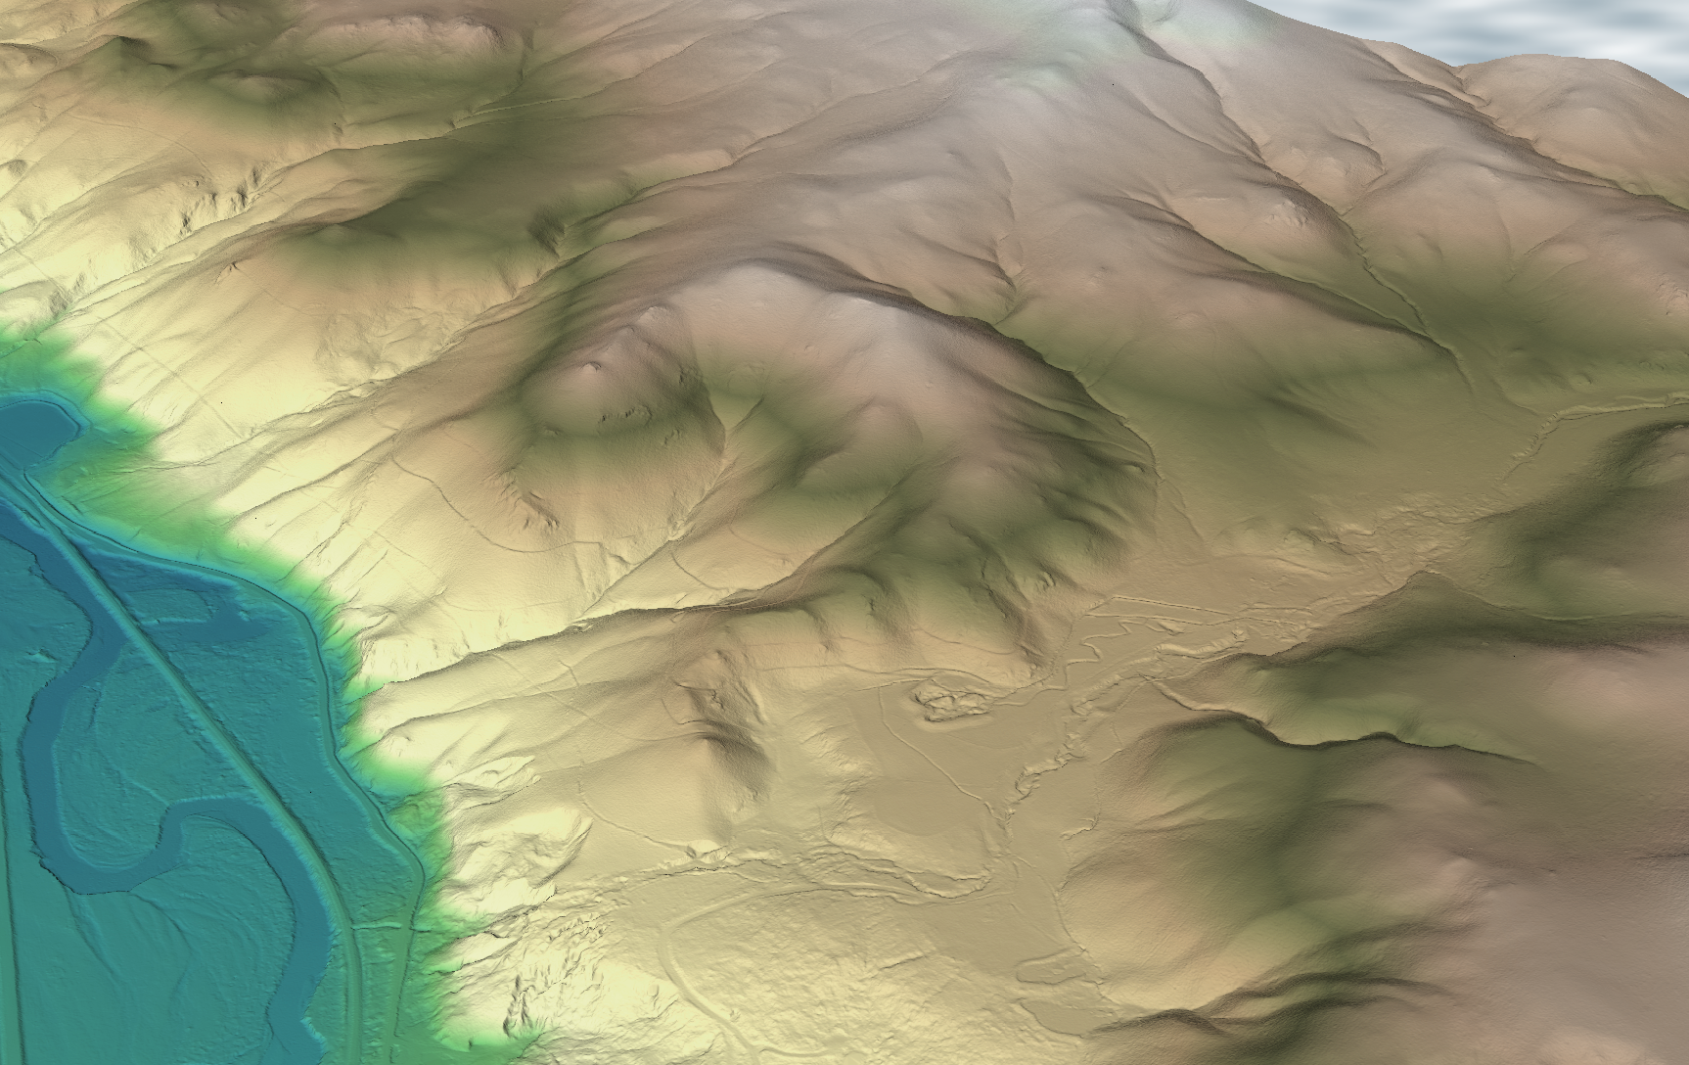
MSDI: Elevation
Transitioning from a statewide 10-meter resolution elevation dataset to 1-meter.
Vertical accuracy will improve from a few meters (RMSE) to less than ½ foot.

Slide 4
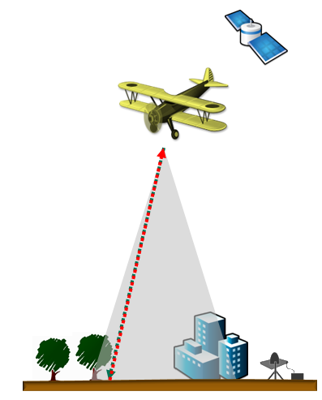
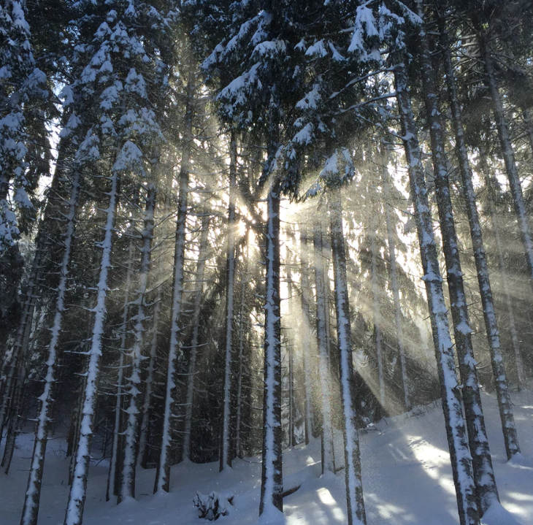
What is lidar?
Measures Distance
Think radar . . .
Think sonar . . .
Think rangefinder . . .
Think laser measuring tool . . .
Image from ESRI ArcGIS Desktop Help
Notes:
Think sonar
Think radar
Think rangefinder
Lidar can see through vegetation . . . sort of.

Slide 5
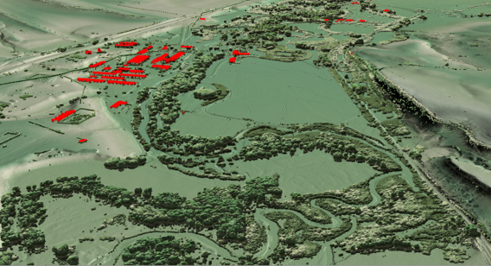
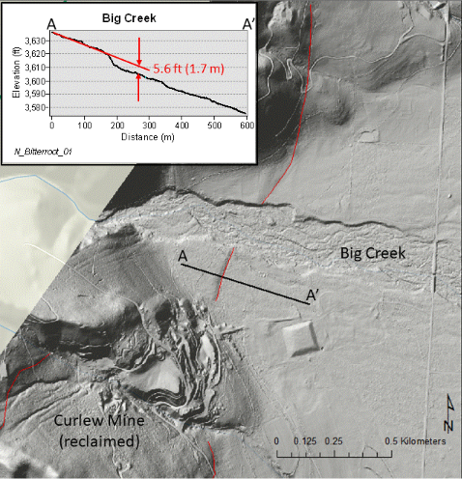
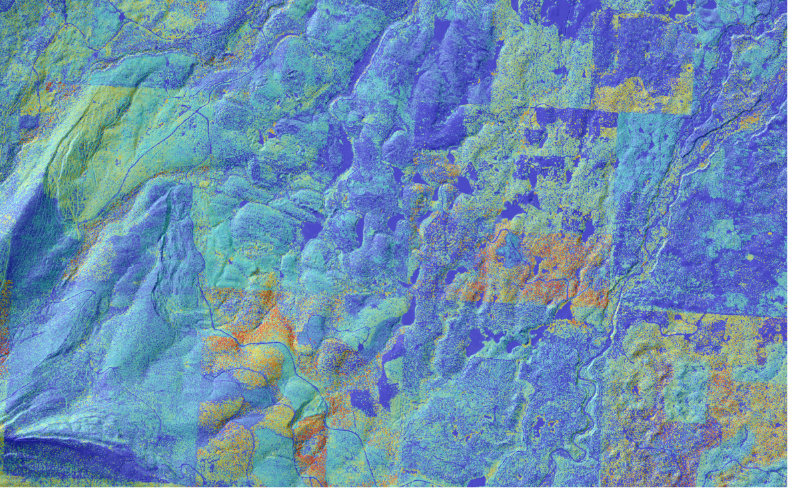
Flood-risk mapping
Hydrologic Modeling
Canopy height
Hazard mapping - Fault
Building footprints

Slide 6
Montana Elevation Working Group
Federal, State, County, local, and private participants

Slide 7
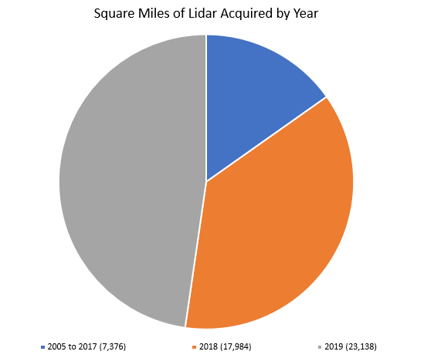
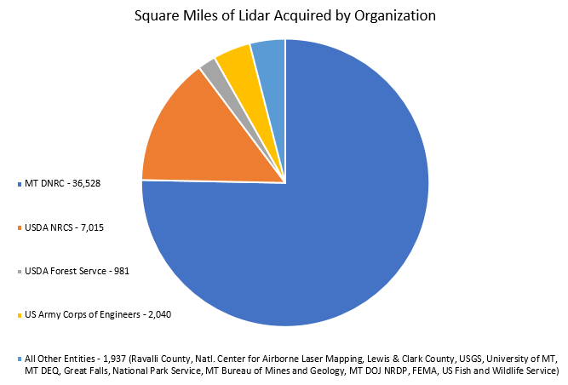
Statewide lidar coverage is about
32% (47,000 square miles)

Slide 8
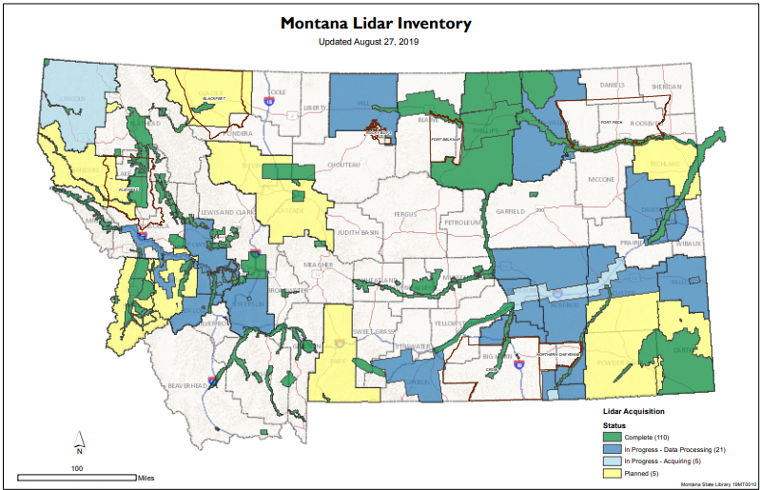
Montana Lidar Inventory
Completed/in-progress acquisitions
Planned lidar acquisitions
Priority areas of interest for future acquisitions
http://msl.mt.gov/gis/lidarinventory

Slide 9
Challenges
Tremendous data storage needs
Current MSL archive: ~25 TB
Coming soon (within next year): ~60 TB
To complete statewide lidar coverage: 300 - 500 TB
Expensive
Larger acquisitions are more cost-effective
Acquisitions should seek to maximize uses and minimize repeat coverage
Notes:
Storage estimates include projections of 2019 data
Coordinate and plan larger (countywide) projects rather than small, single project efforts

Slide 10
Trends to think about
Data are scattered about, especially smaller projects, and often not readily available
Need single repository (MSL is working on this)
More lidar is being flown by drone
Small project size
Quality level and standards
Metadata is often neglected
MSL and the Montana Spatial Data Infrastructure (MSDI) Elevation Working Group have a decent handle on aircraft lidar (we think) . . . but what about drone lidar?

Slide 11
THANK YOU
QUESTIONS/COMMENTS PLEASE.
http://msl.mt.gov/gis/lidarinventory

