Slide 1
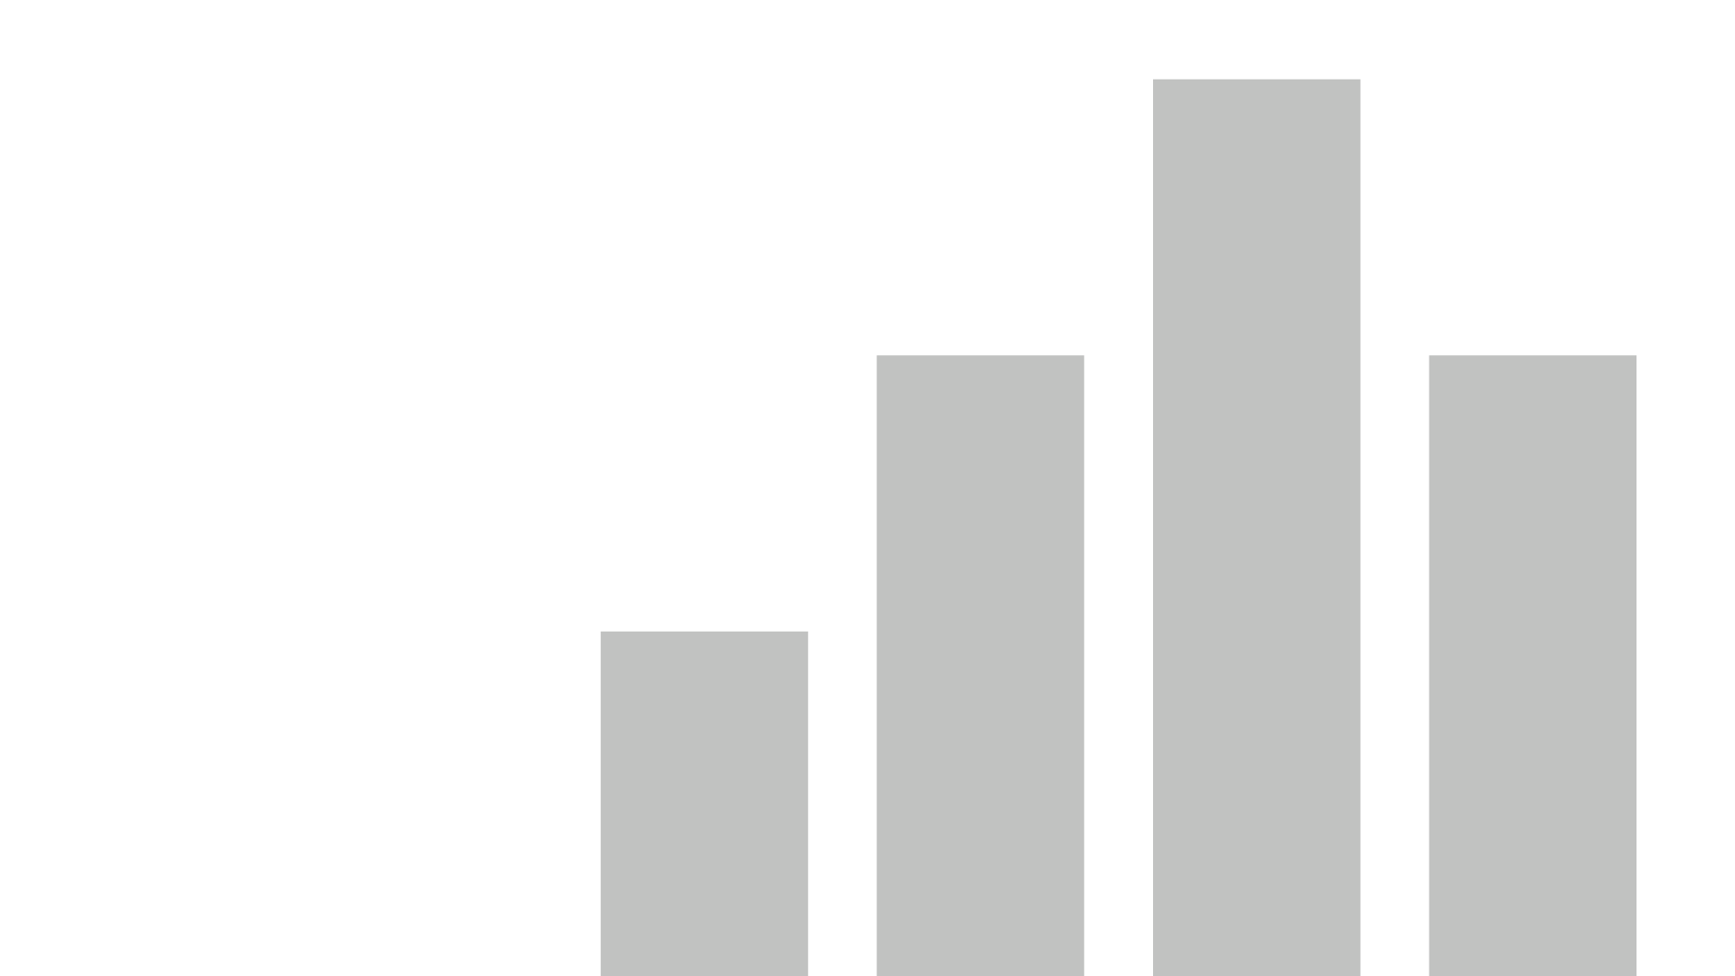
Microsoft Office 365 Usage Analytics
https://O365.MT.Gov
Last data refresh:
11/27/2019 12:12:08 AM Mountain Standard Time
Downloaded at:
11/27/2019 10:12:13 AM Mountain Standard Time

Slide 2
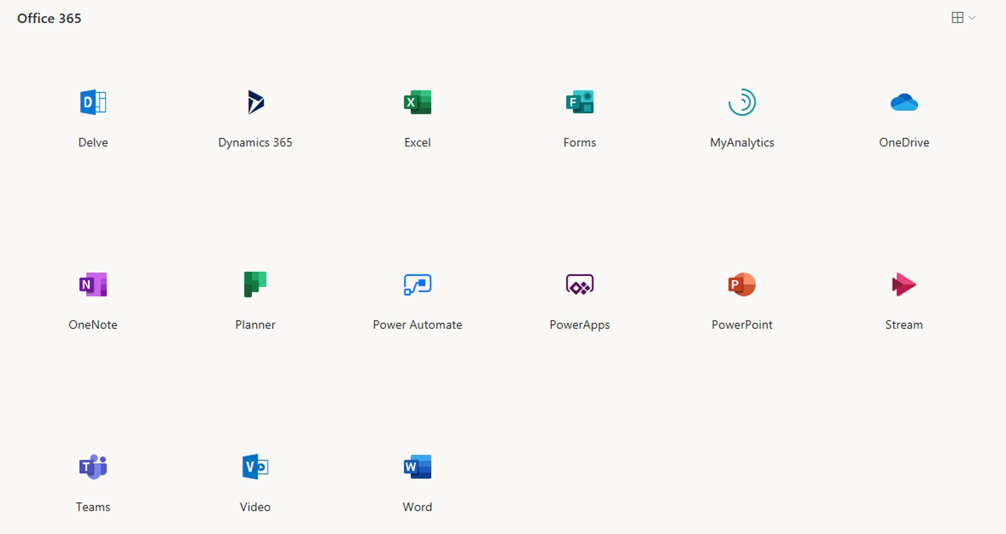

Slide 3
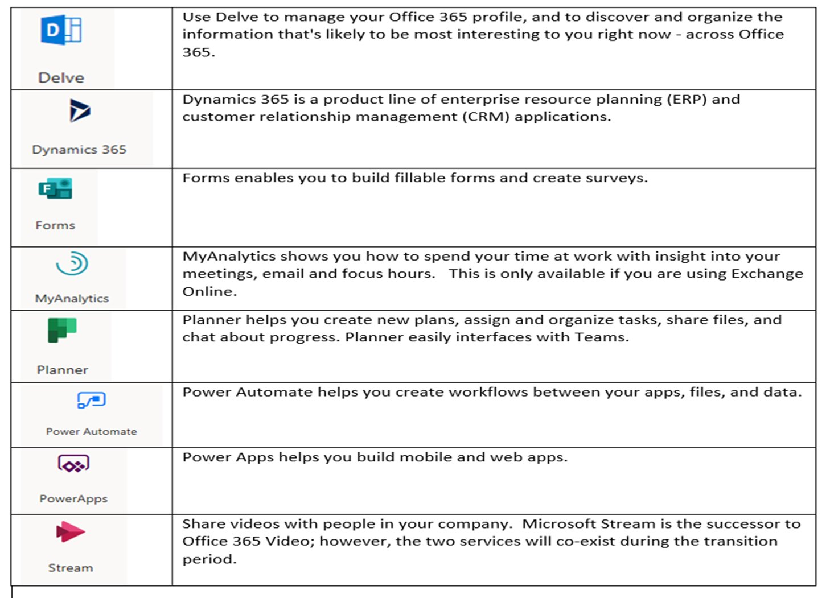

Slide 6
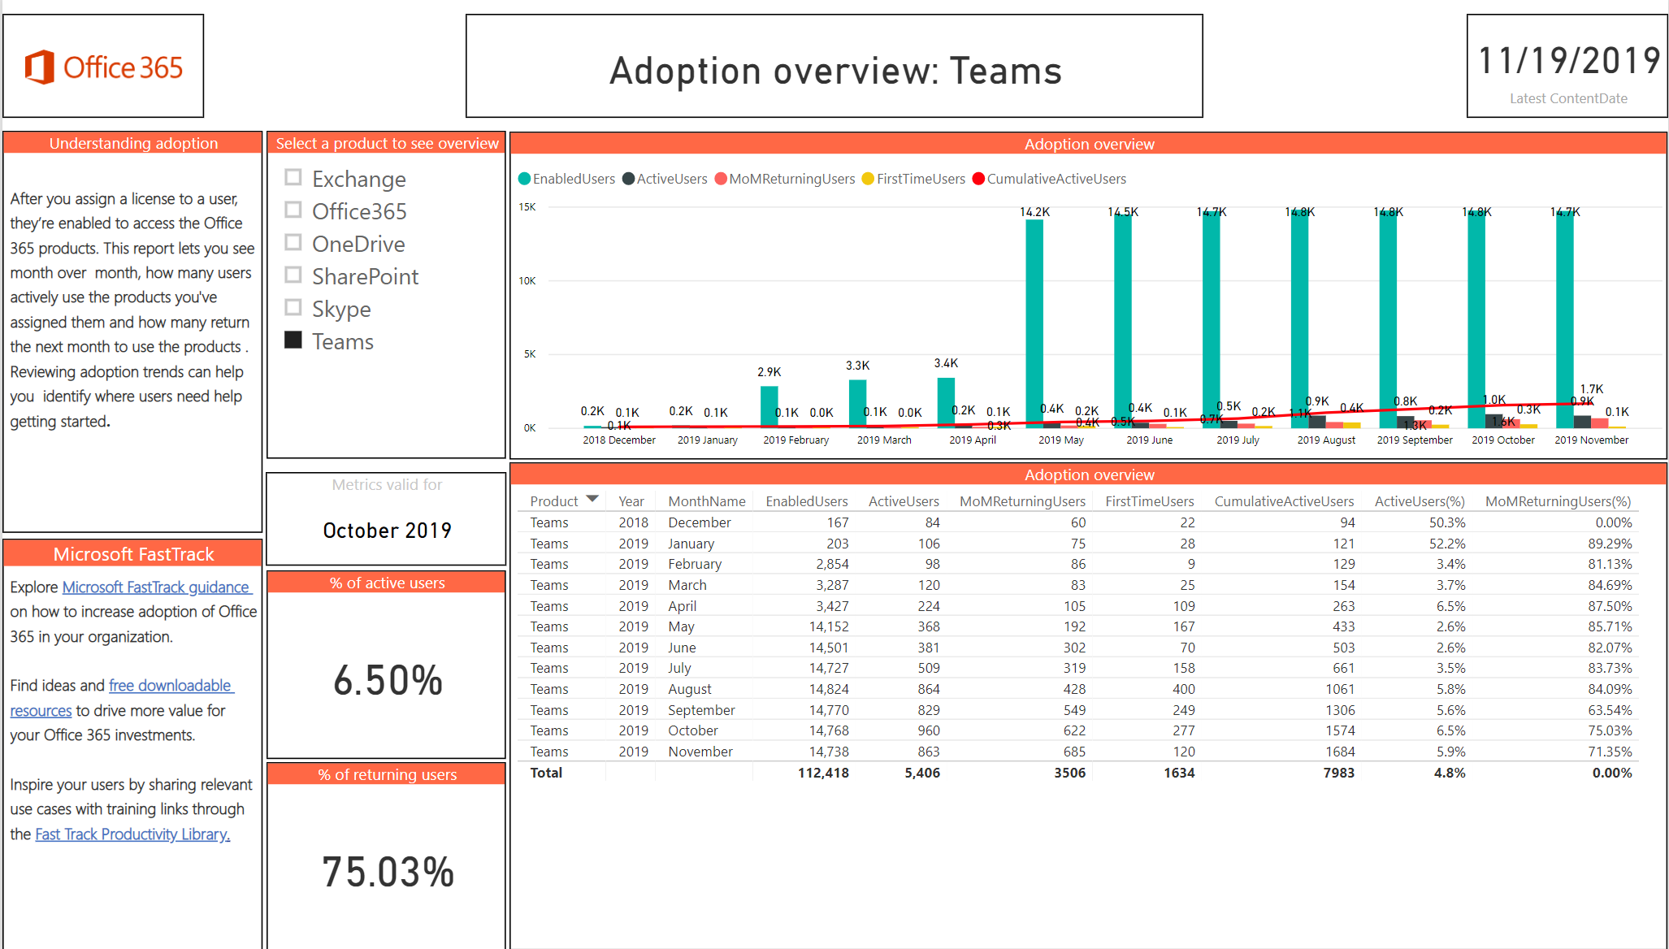

Slide 8
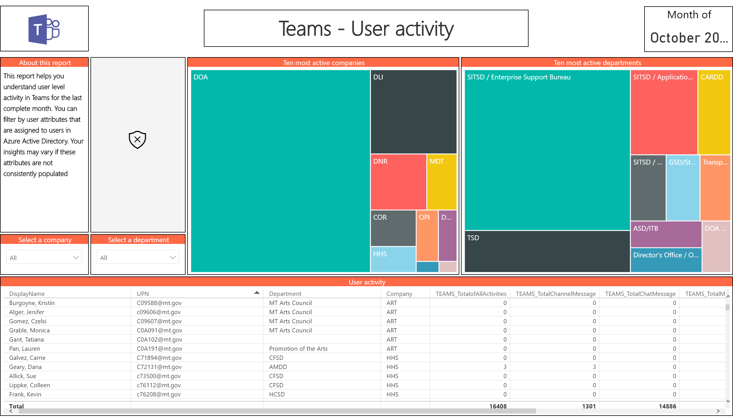

Slide 9
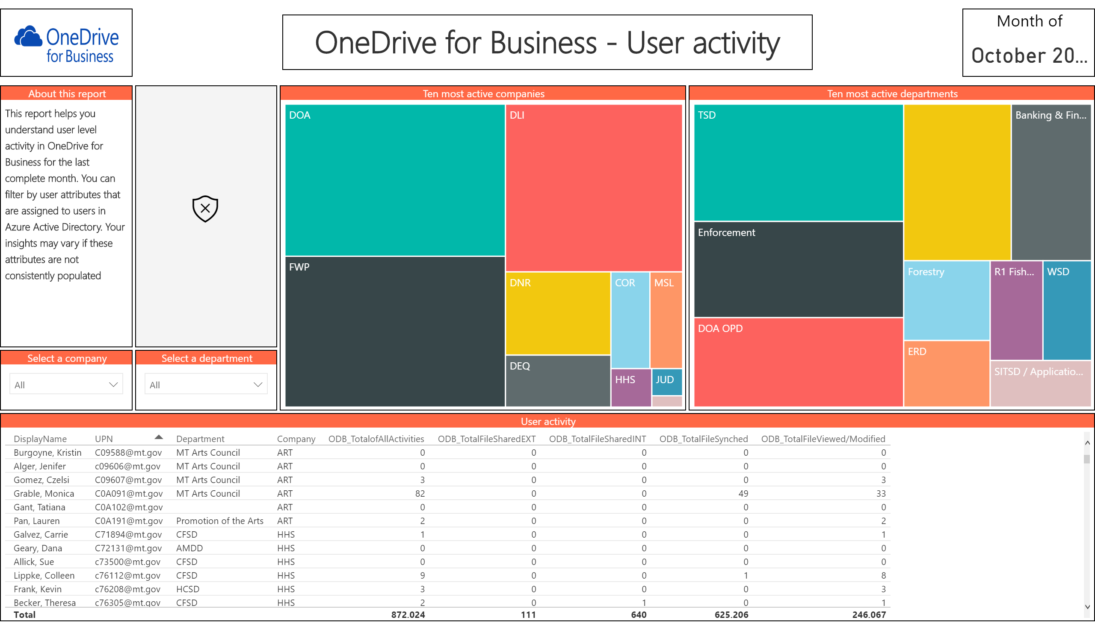

Slide 10
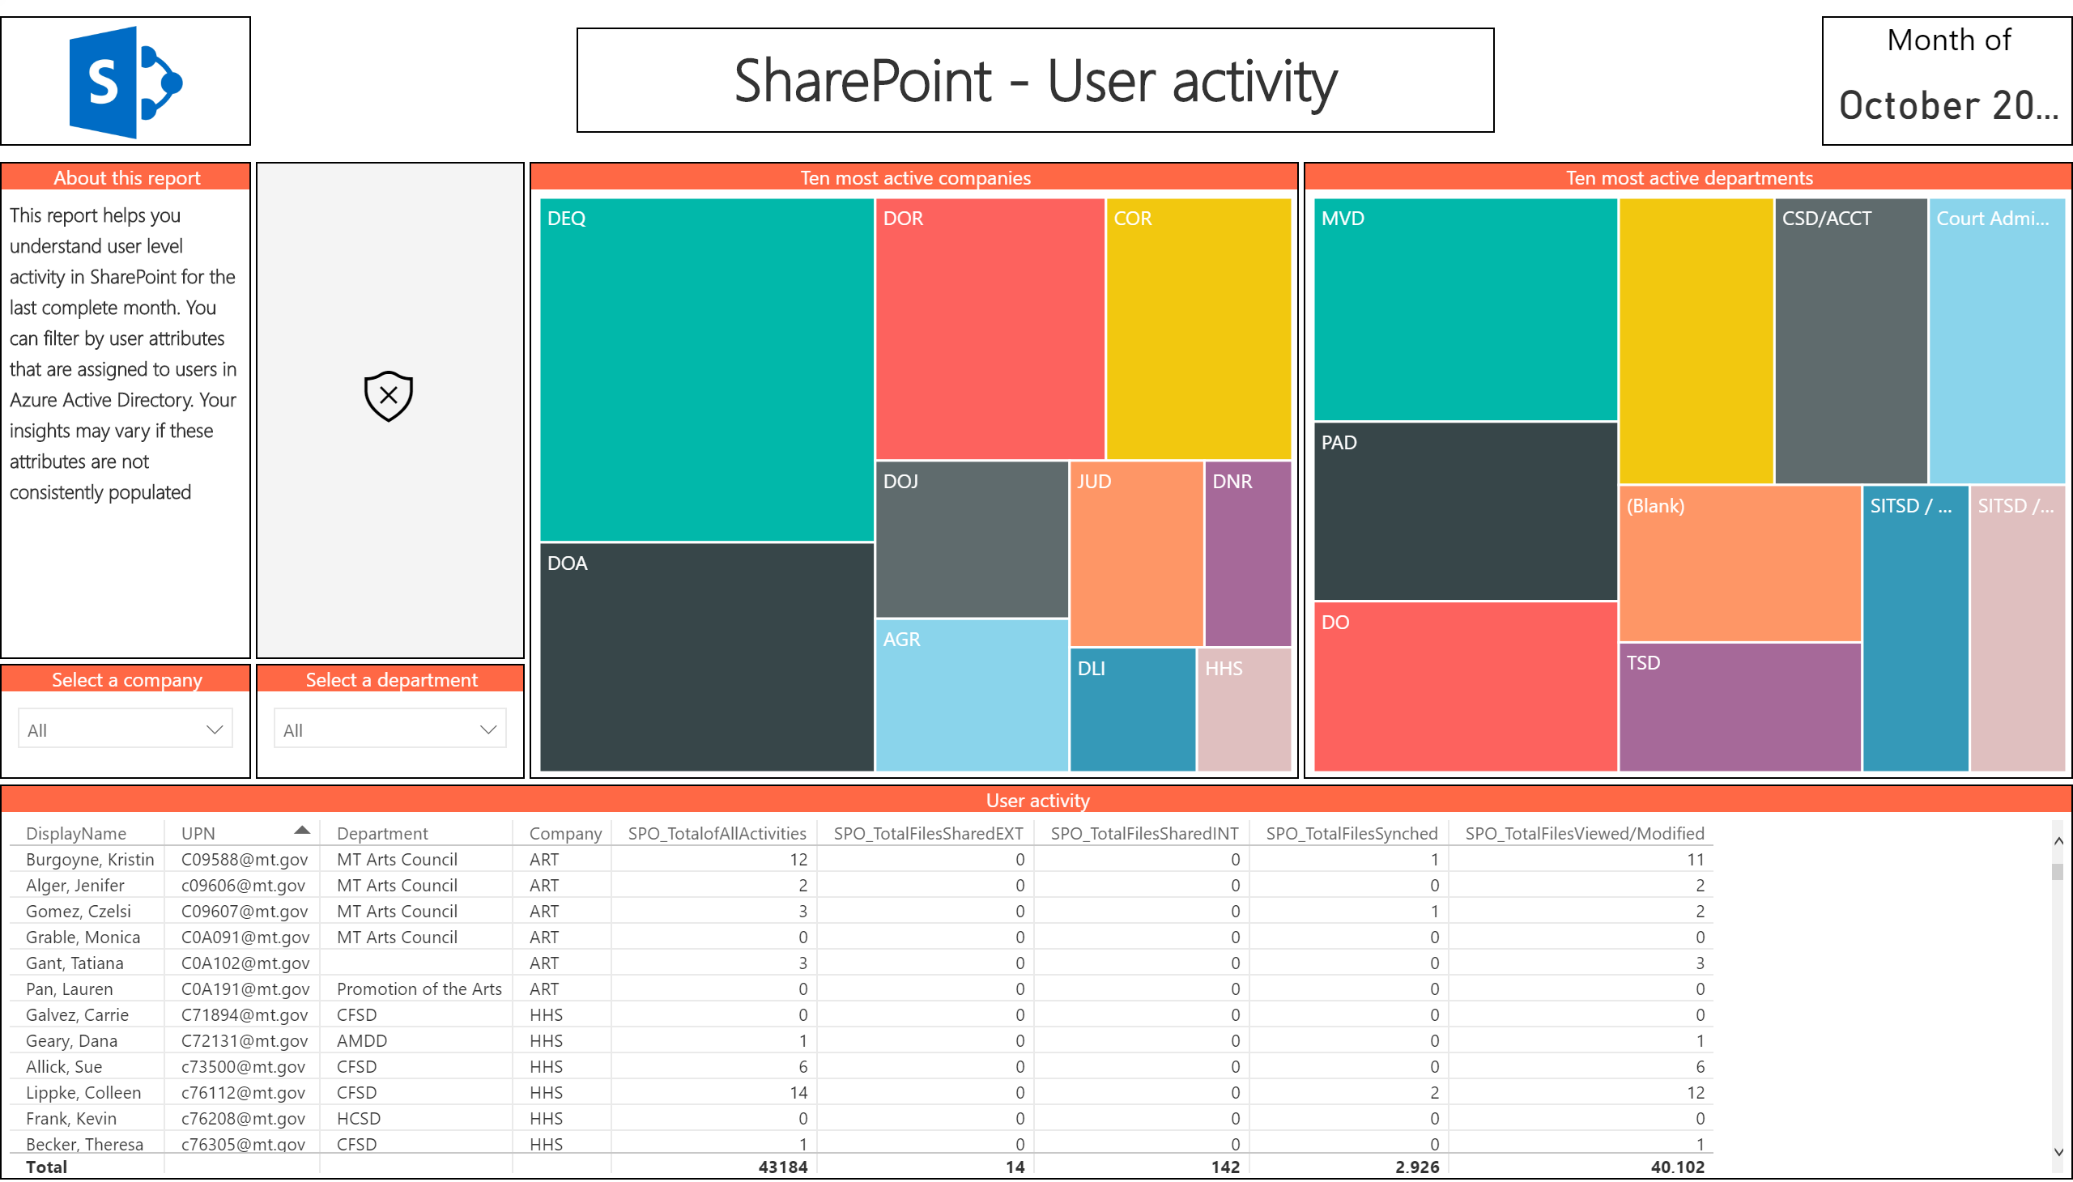

Slide 11
Questions?
https://O365.MT.Gov

