Slide 1

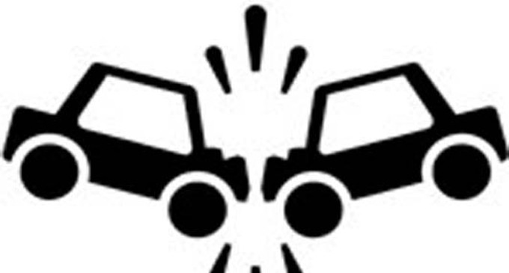
RISK MANAGEMENT & TORT DEFENSE
Guide To Motor Vehicle Accidents

Slide 2
What should you do if you find yourself at the scene of, or involved in an accident?
Contact Law Enforcement
If the accident occurs in a municipality, you must report the accident to the local police if anyone is injured or killed, or the property damage exceeds $500. If it occurs outside of a municipality, you must contact the Montana Highway Patrol if anyone is killed or injured, or the property damage exceeds $1,000.

Slide 3
Check for injuries
Render assistance
Contact your immediate Supervisor

Slide 4
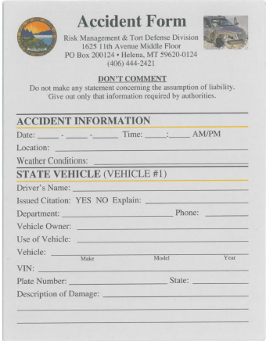
RMTD ACCIDENT FORM
Each vehicle should have an Accident Form for your use at the scene of an accident in the glove box. Additional forms are available -
State Agencies and Universities Reporting A Loss (mt.gov)

Slide 5
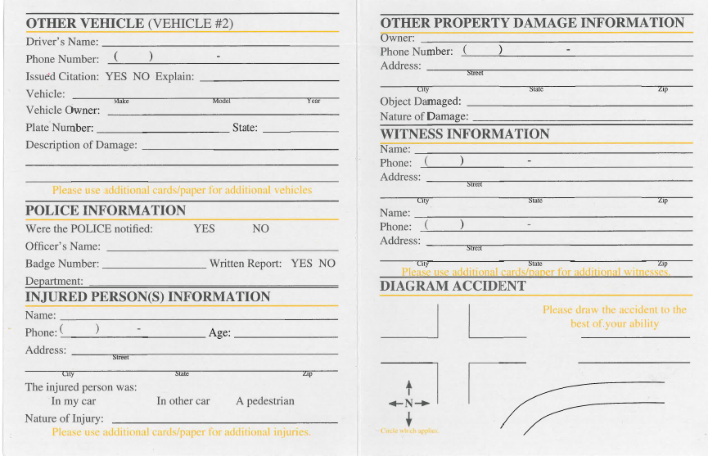
The Accident Form is a tool designed to walk you through what information to collect, what to say and do at the accident scene.
RMTD does not collect these, they are strictly for your use only.

Slide 6
Who What Where When

Slide 7
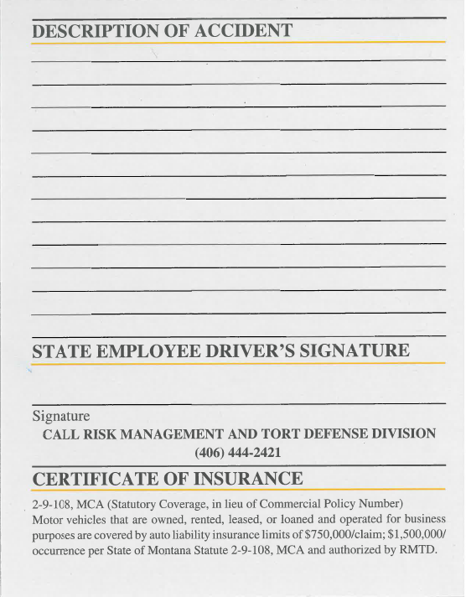
It is your Proof of Insurance

Slide 8
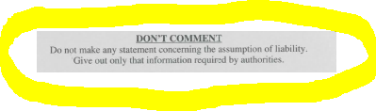
Don’t furnish information on the incident to any unauthorized persons, other than law enforcement officials. If you are unsure, refer the person to us or take their name and number and call us. Do not give statements without our involvement.
Do not make statements or give opinions as to fault.
Make no commitments and do not attempt to negotiate any type of settlement.
Try neutral non-accusatory statements.

Slide 9
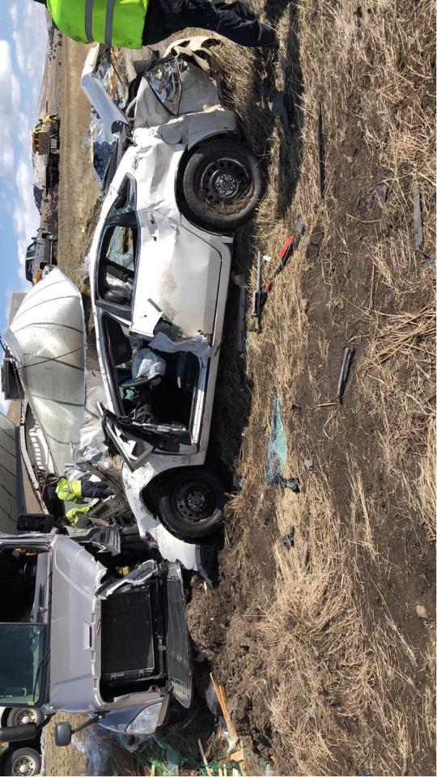
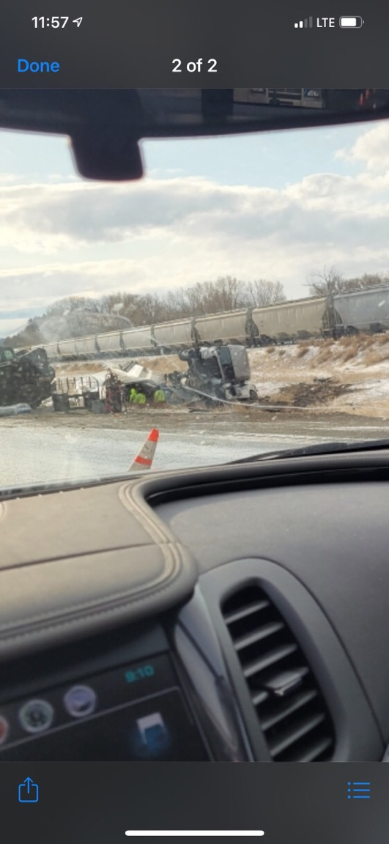
Take Photos
…And More Photos
There is no such thing as too many photos!

Slide 10
What Next?
ANY ACCIDENT INVOLVING A FATALITY OR BODILY INJURY TO ANOTHER PARTY, SHOULD BE PHONED BY THE EMPLOYEE OR IMMEDIATE SUPERVISOR TO RMTD IMMEDIATELY (WITHIN 24 HOURS).
If there are no injuries, but the accident involves another party, contact RMTD preferably within 24 hours, 48 hours at the latest.

Slide 11
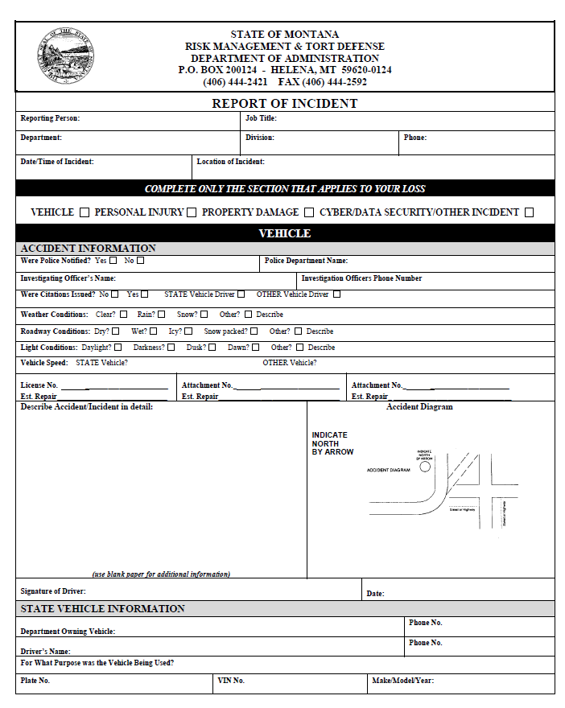
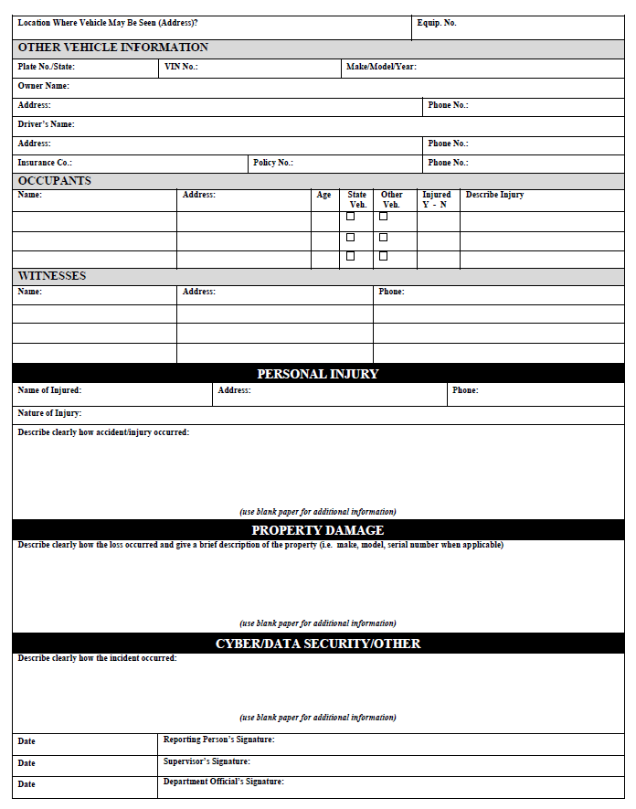
Complete Report of Incident (ROI)

Slide 12
Use the information you gathered on the Accident From to complete the ROI
Follow your Agencies procedures for turning in the completed ROI.

Slide 13
Key take a ways
Stay calm
Request Police assistance
Check for injuries
Exchange information, document specifics, identify witnesses, and take photos
Be careful what you say
Never admit fault to anyone
Do not leave the scene unless cleared to do so by police
Notify Supervisor
Notify RMTD

